Slide 1
SQL Day 2

Slide 2
Day | Topic | Chapter Details | Time Duration
Day 2 | Operators | Debugging errors | 60 mins
 |  | SQL style
 |  | Using WHERE with numbers
 |  | Using WHERE with text
 |  | Using AND and OR
 |  | Using BETWEEN
 |  | Filtering text
 |  | LIKE and NOT LIKE
 | 5 mins Break
 | Built-in functions | WHERE IN | 60 mins
 |  | Combining filtering and selecting
 |  | NULL values
 |  | What does NULL mean?
 |  | Aggregate functions and data types
 |  | Practice with aggregate functions
 |  | Summarizing subsets
 |  | Combining aggregate functions with WHERE
 |  | Using ROUND()
 |  | ROUND() with a negative parameter
 |  | Aliasing and arithmetic; functions

Slide 3
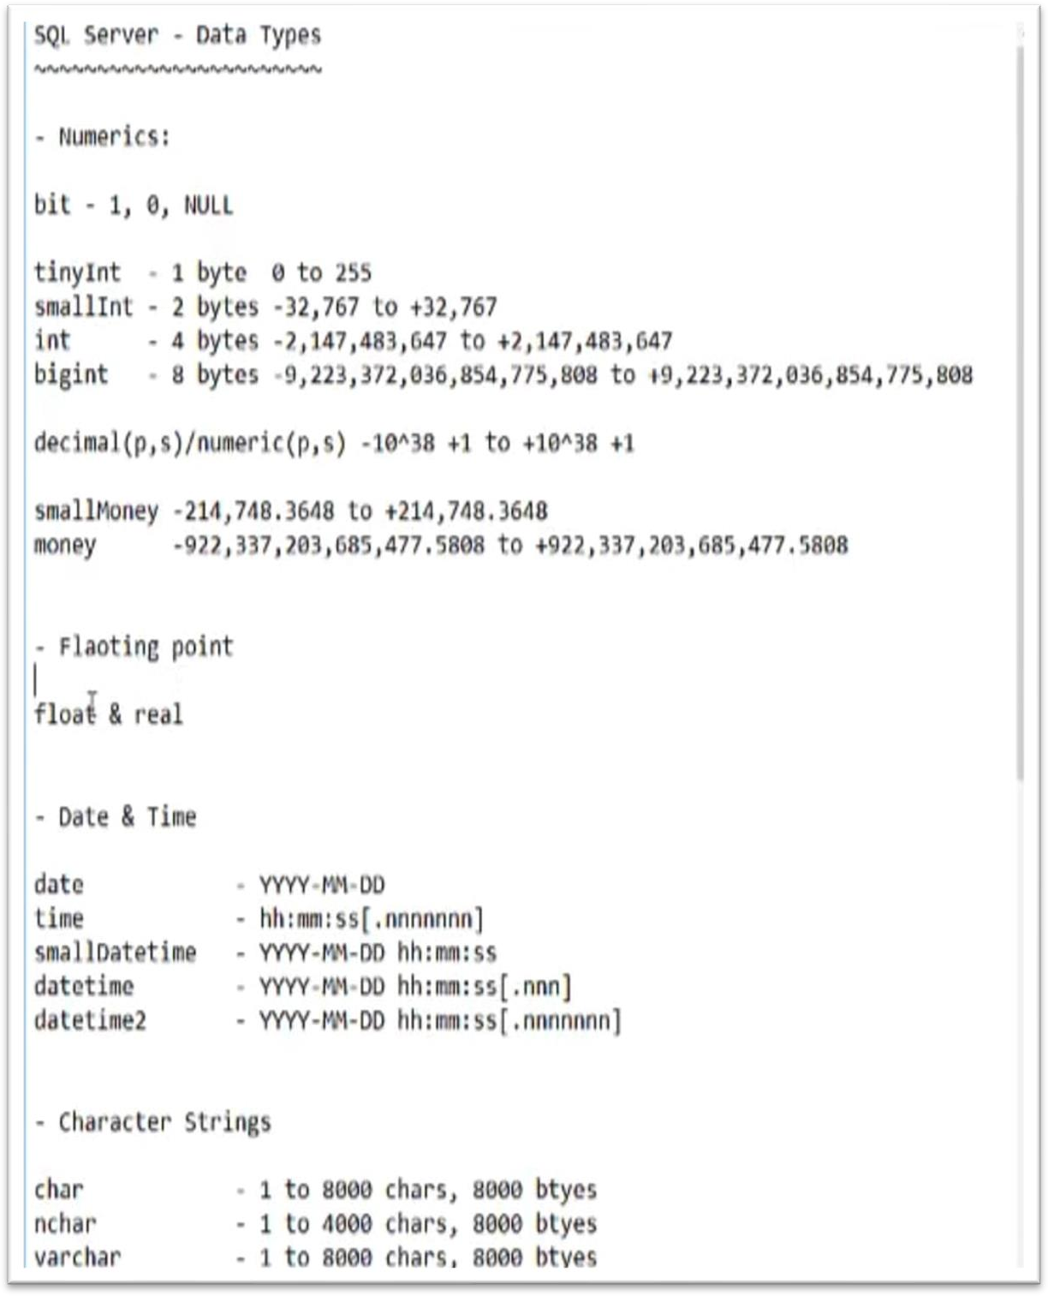

Slide 4
Recap:
DECLARE @VAR DECIMAL(6,2)
SET @VAR=100.55
SELECT @var
DECLARE @b char(5);
SET @b='SQL';
SELECT @b
DECLARE @a int; SET @a=2; SELECT @a

Slide 5
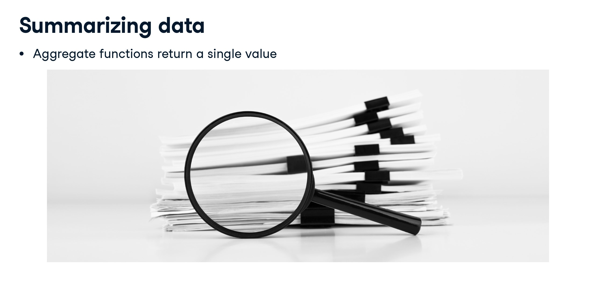

Slide 6
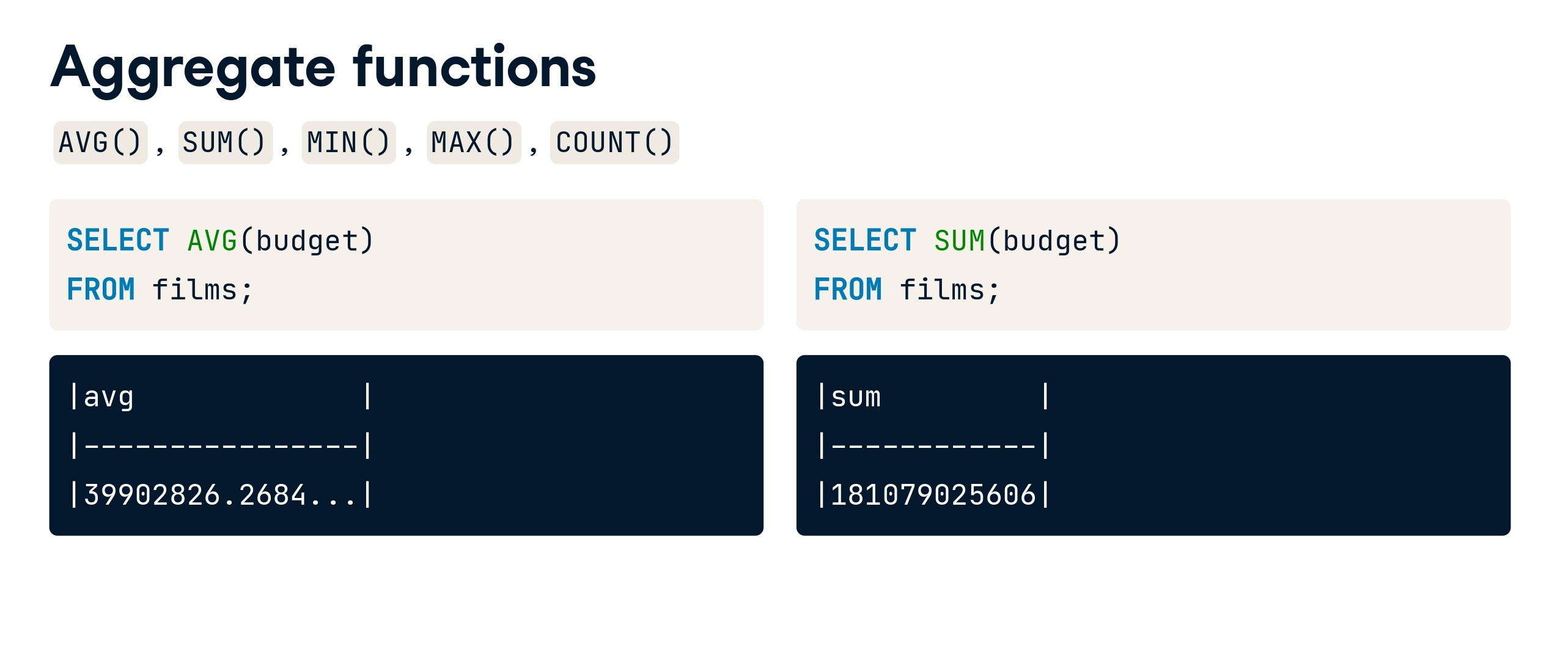

Slide 7
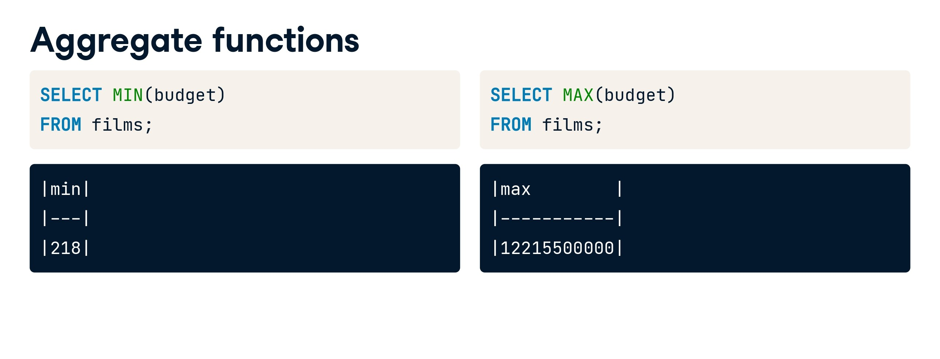

Slide 8
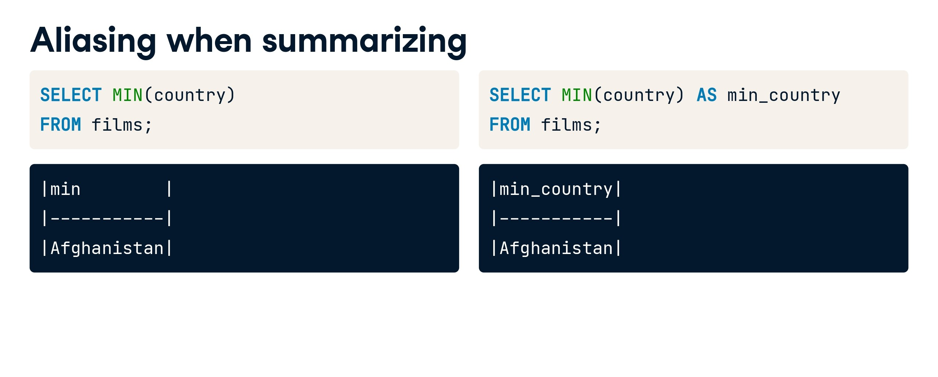

Slide 9


Slide 10
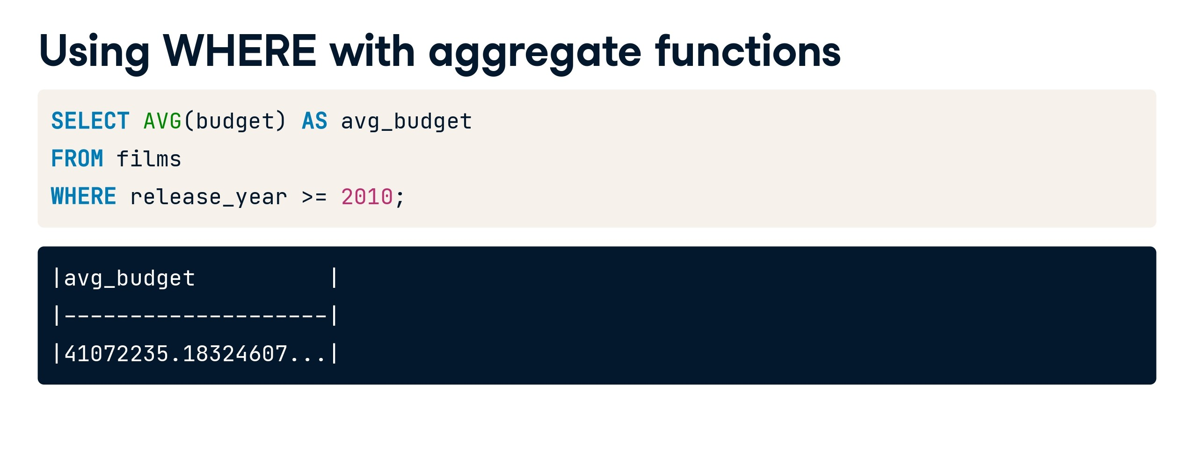

Slide 11
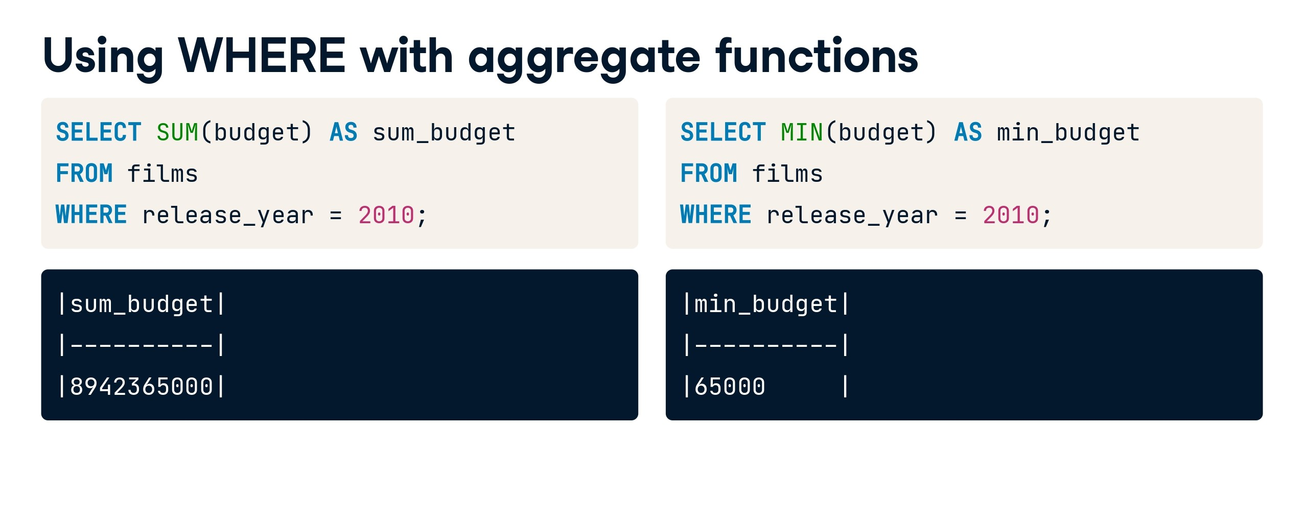

Slide 12
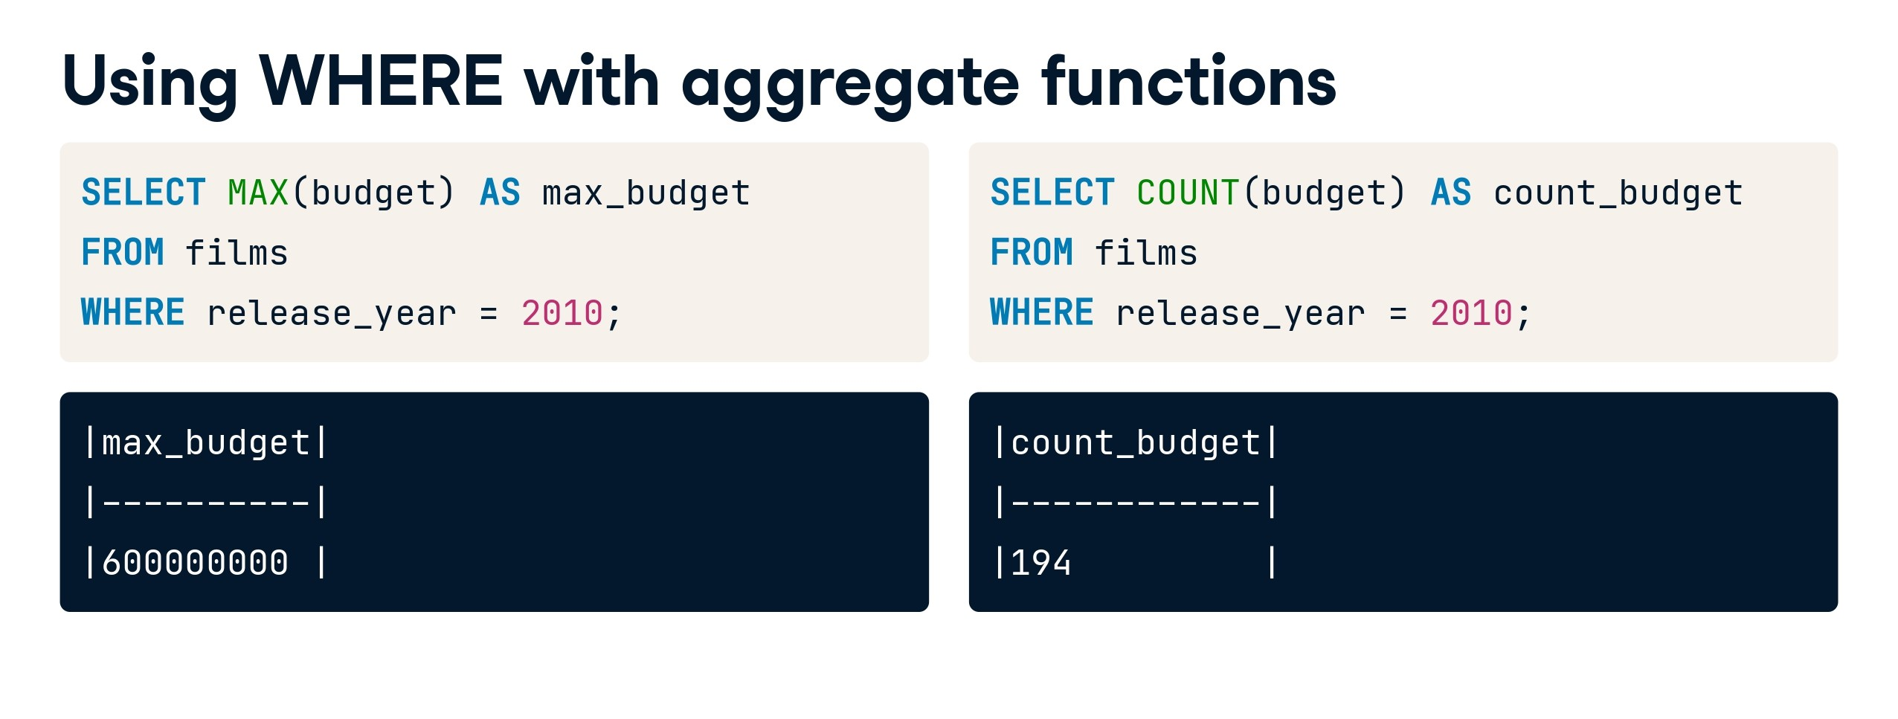

Slide 13
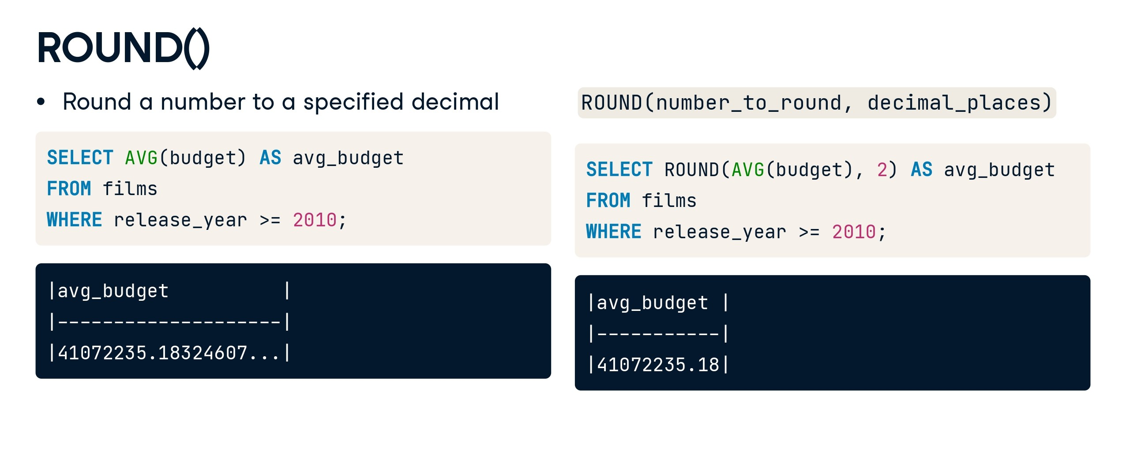

Slide 14
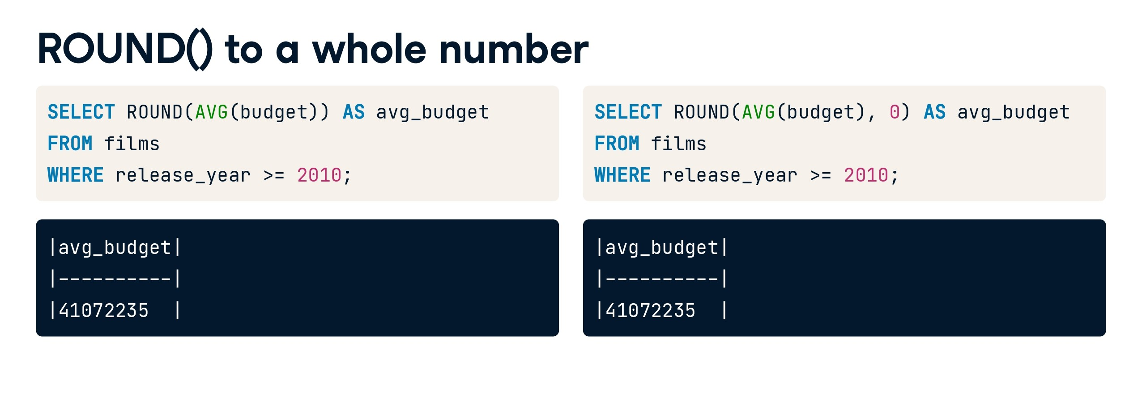

Slide 15
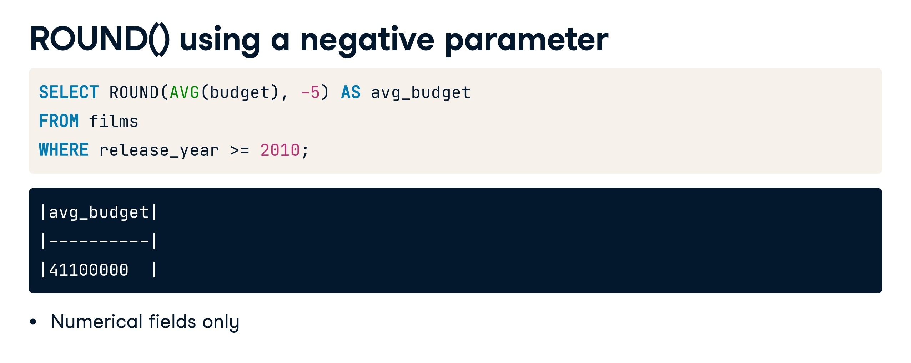

Slide 16


Slide 17
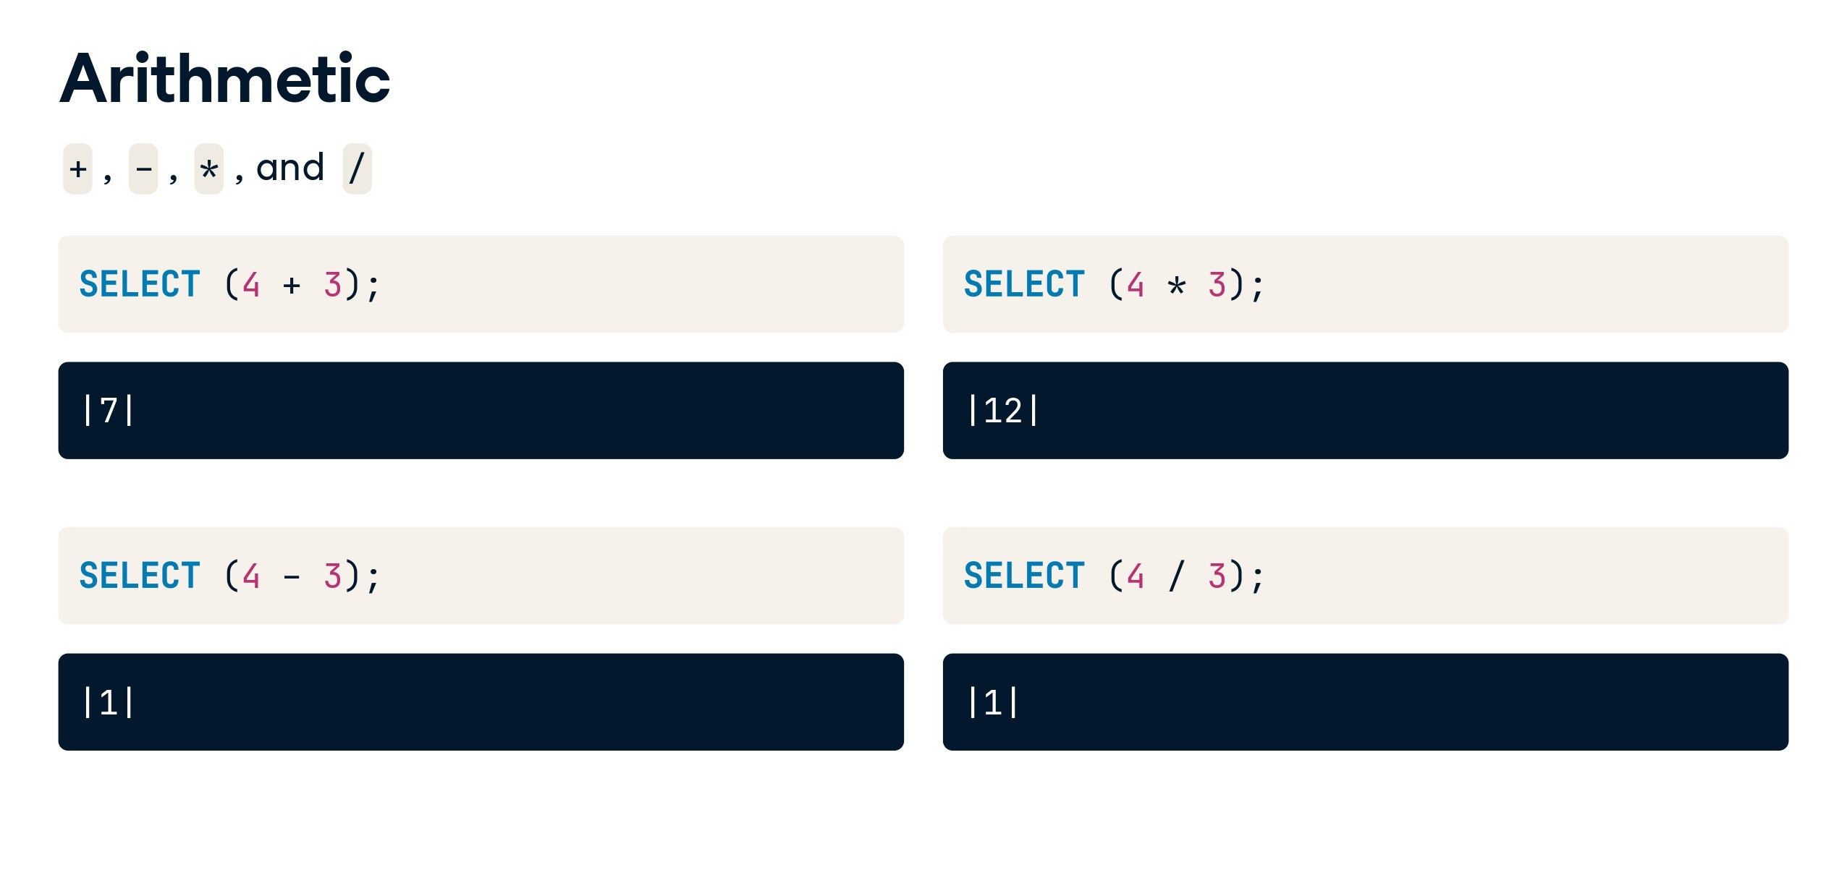

Slide 18
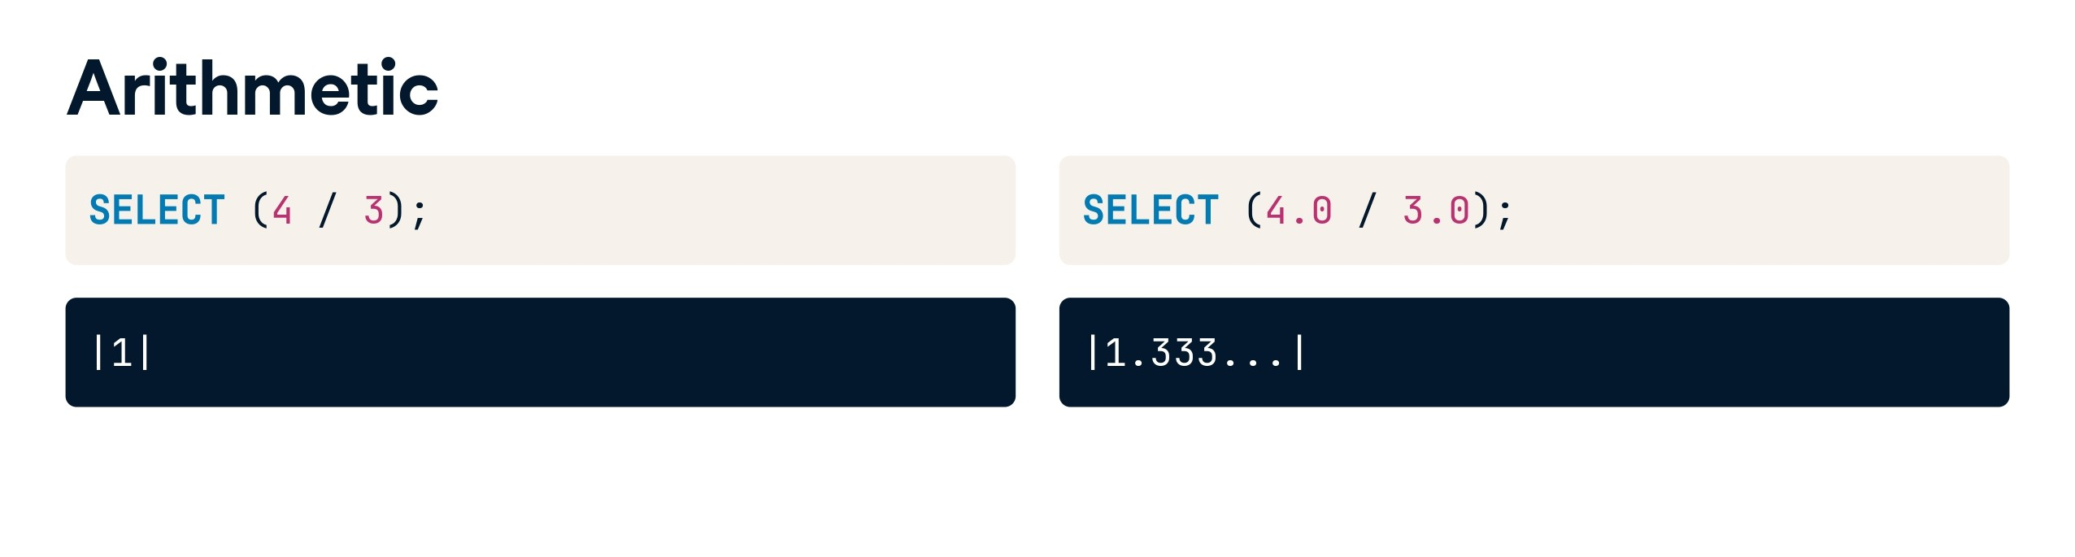

Slide 19
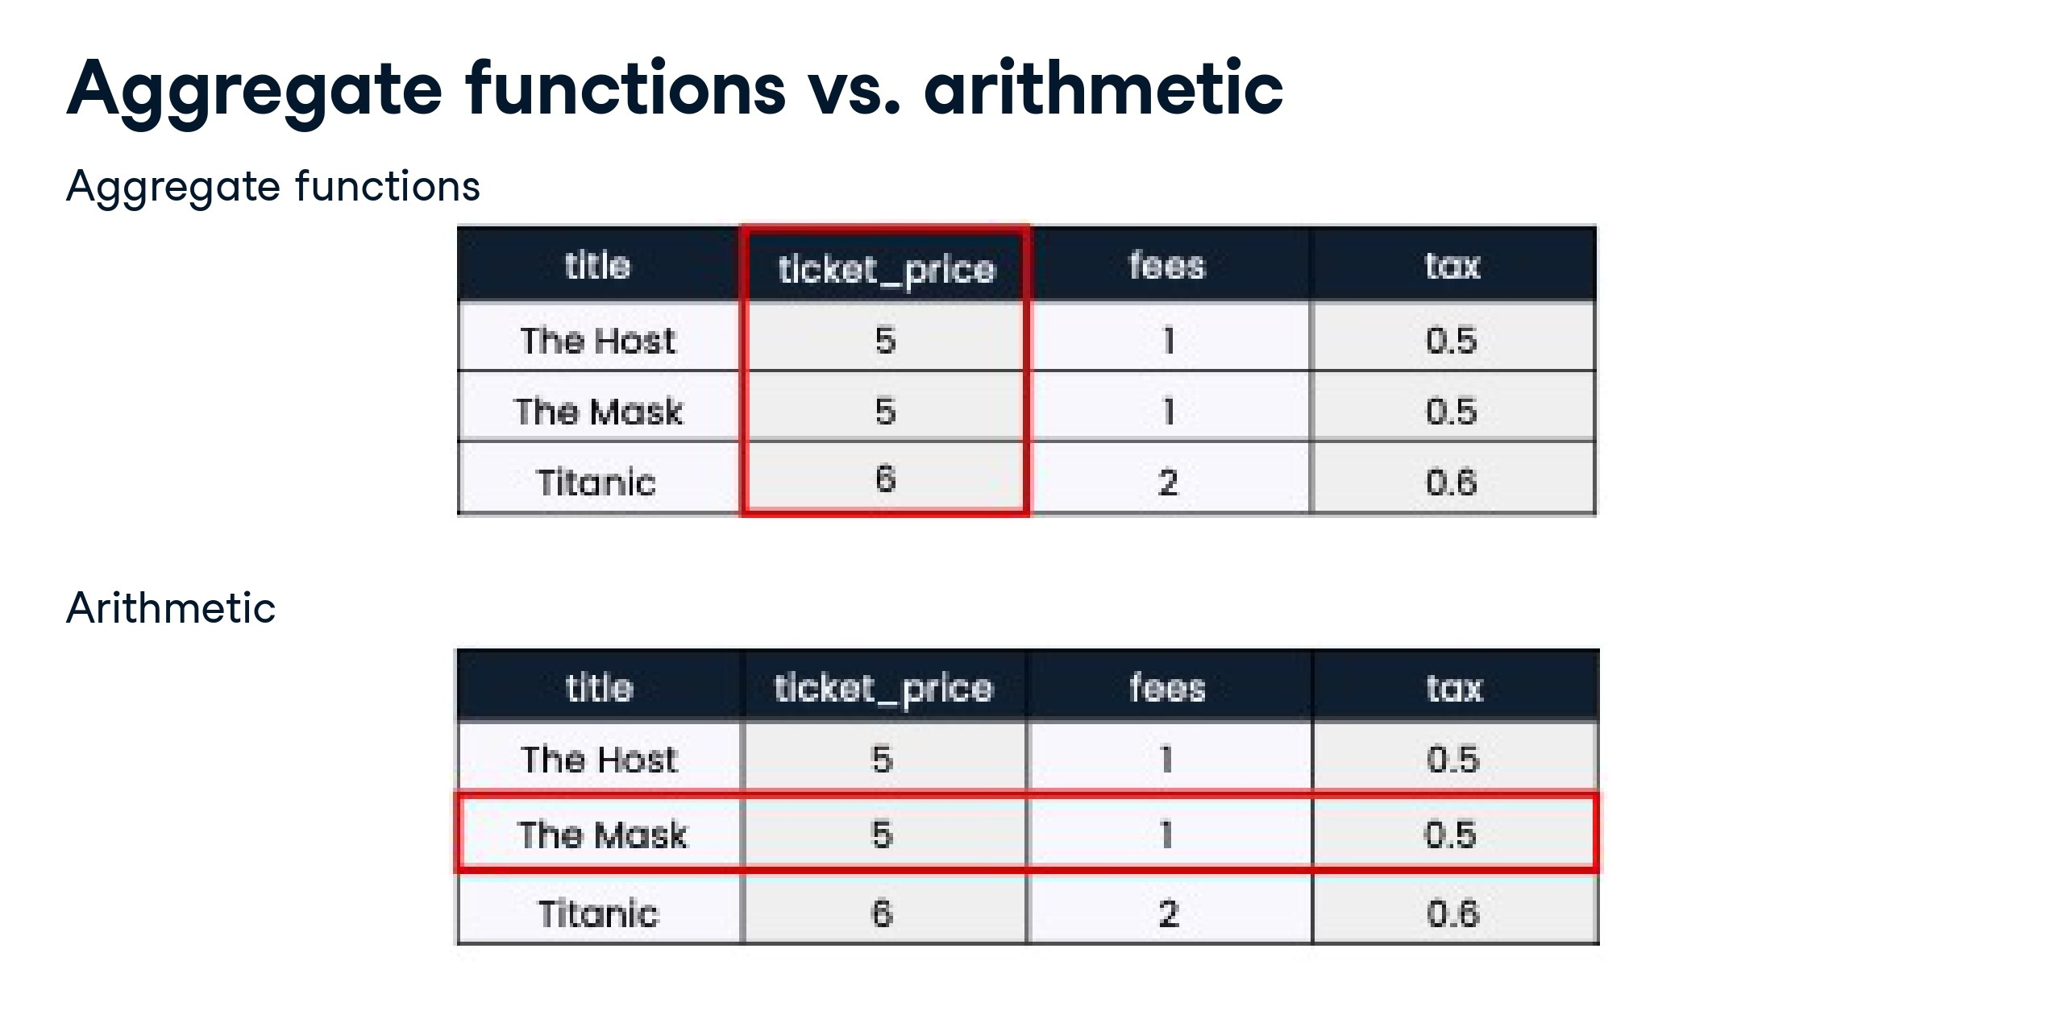

Slide 20
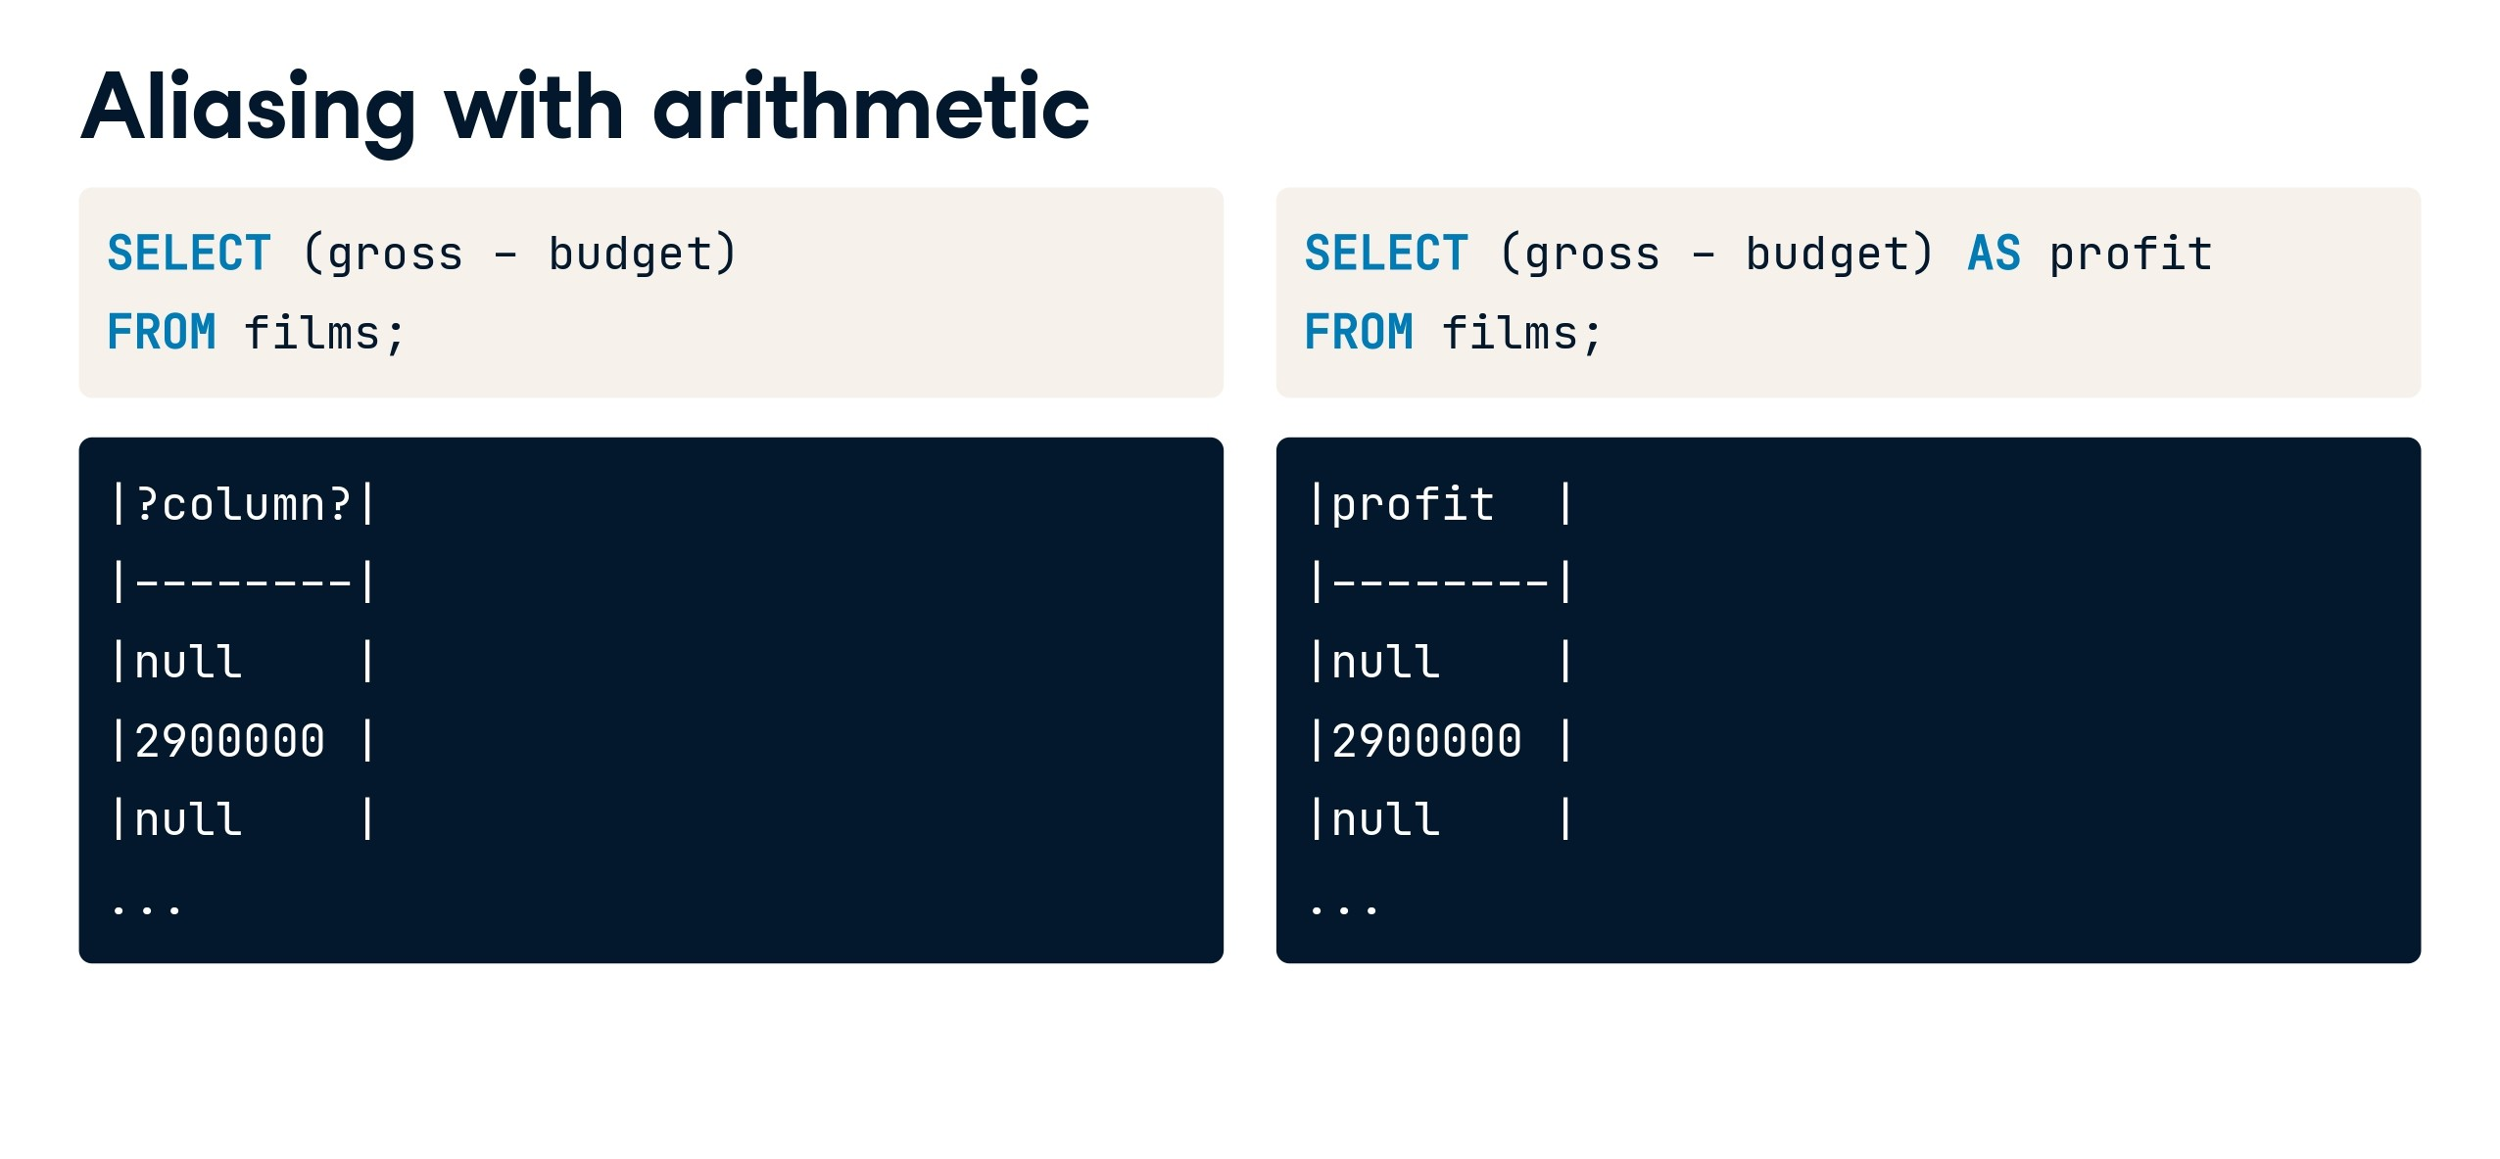

Slide 21
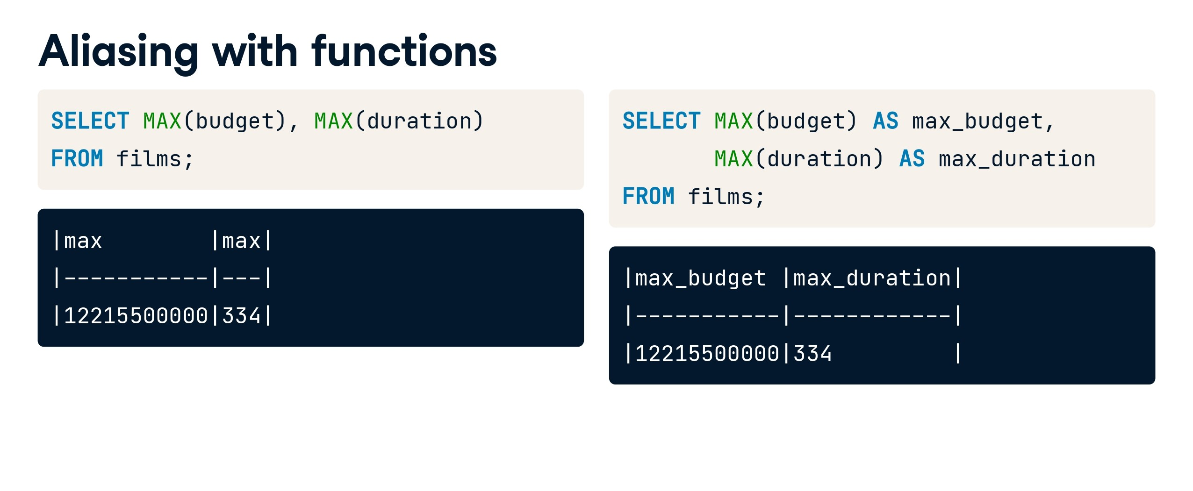

Slide 22
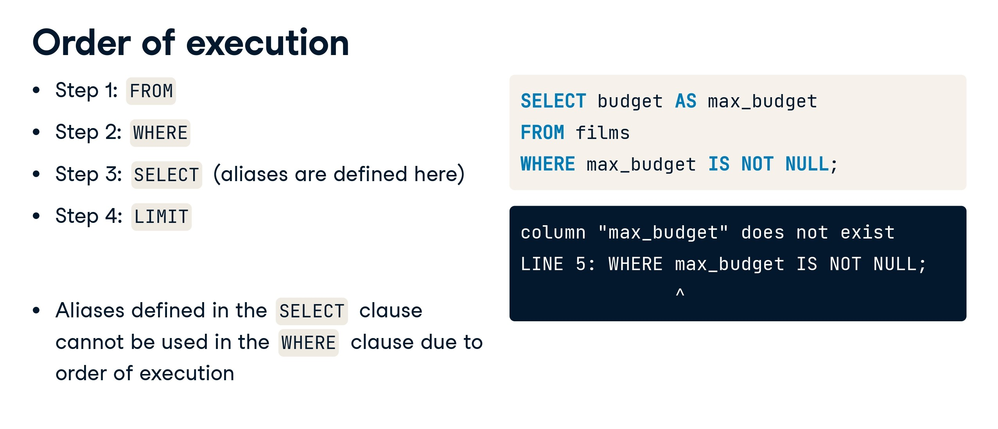

Slide 23
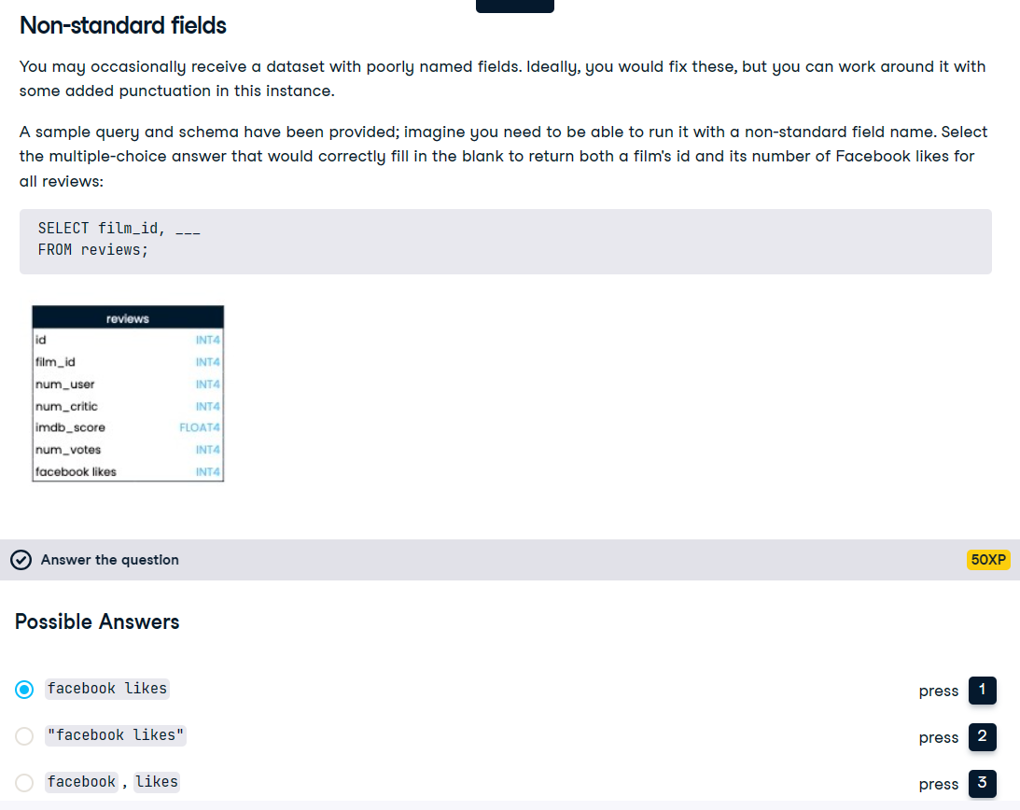

Slide 24


Slide 25
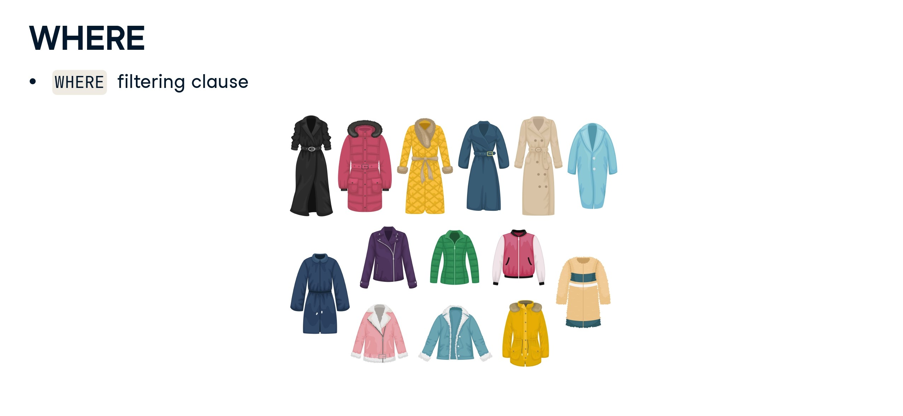

Slide 26
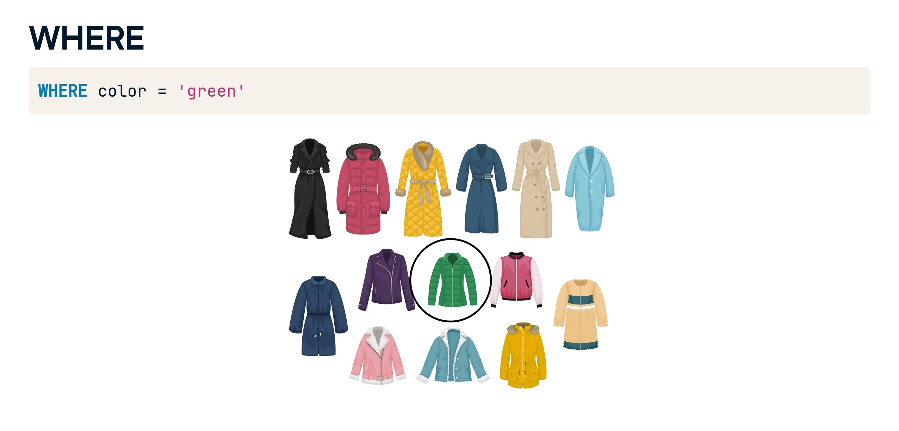

Slide 27
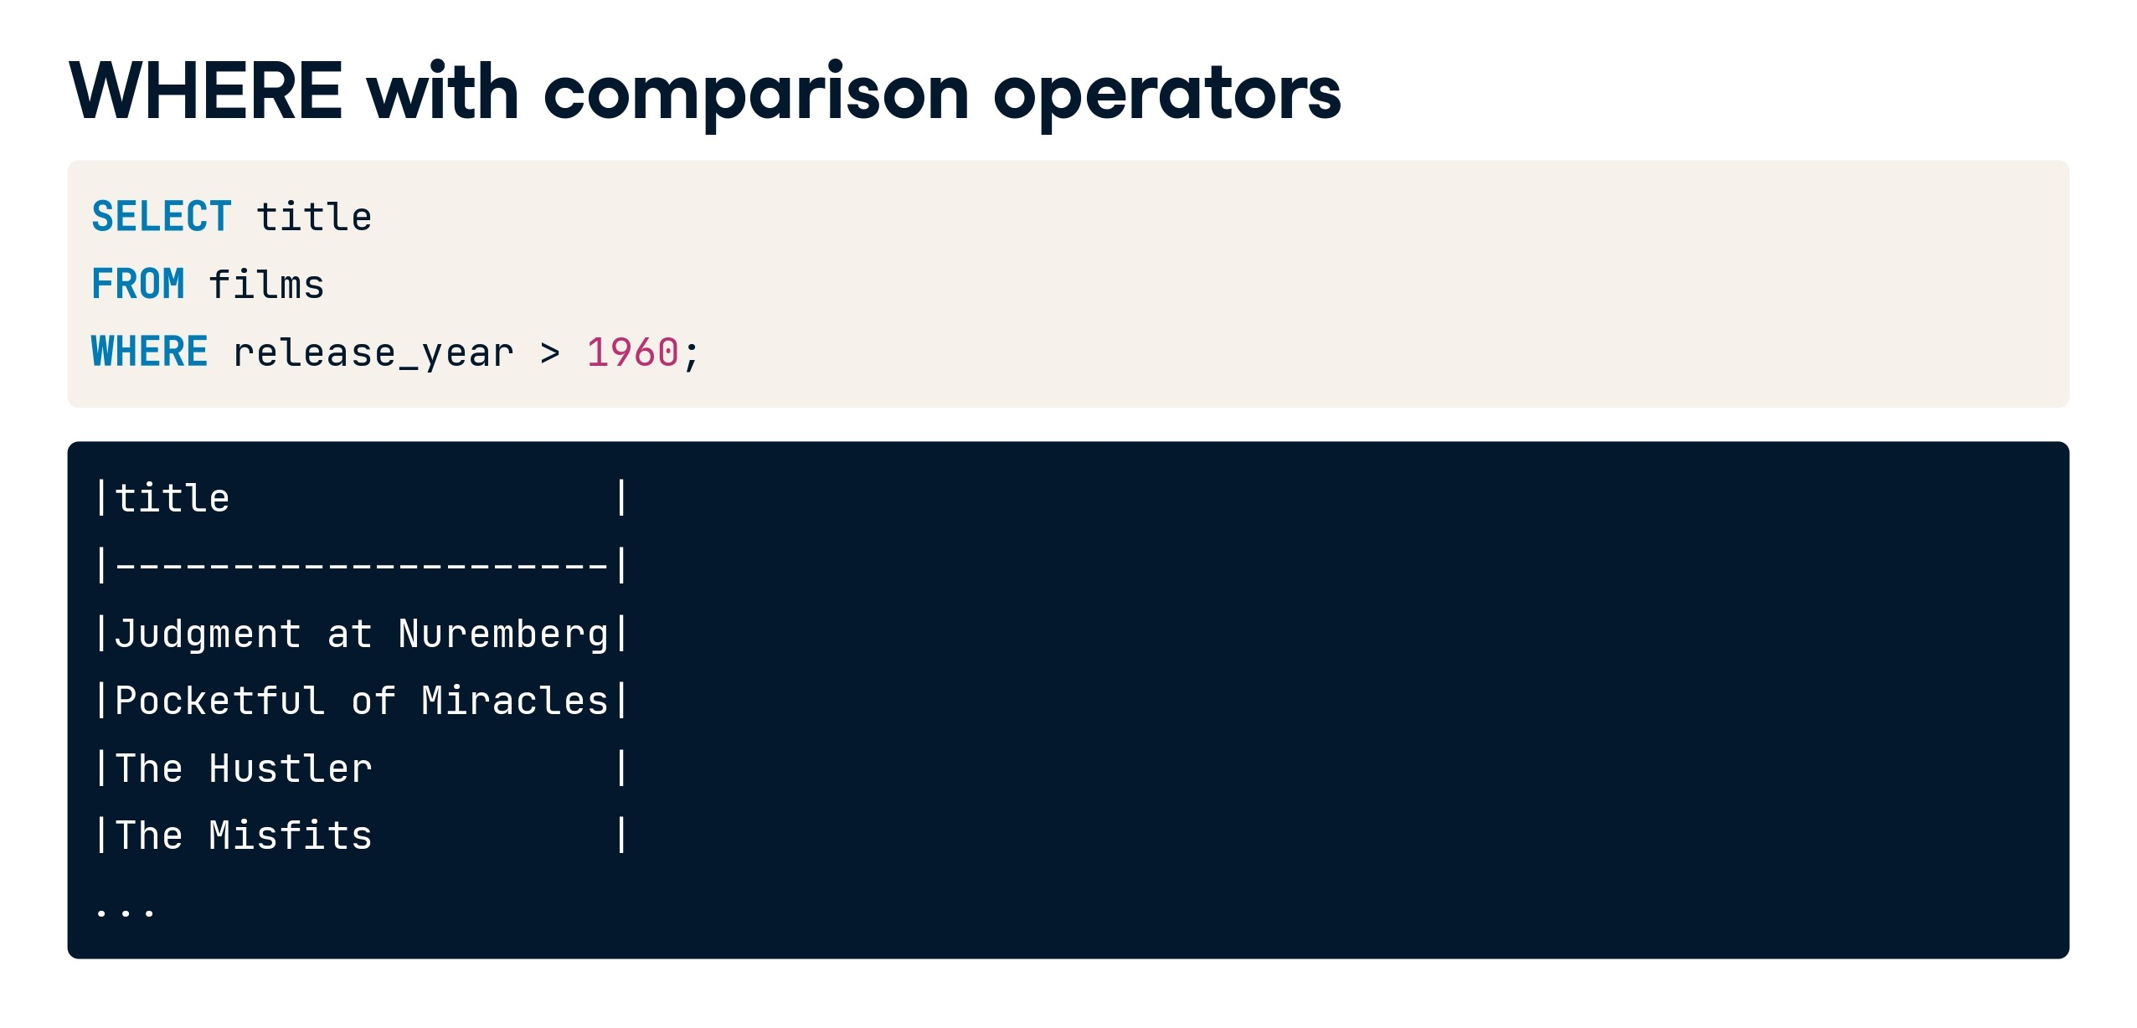

Slide 28
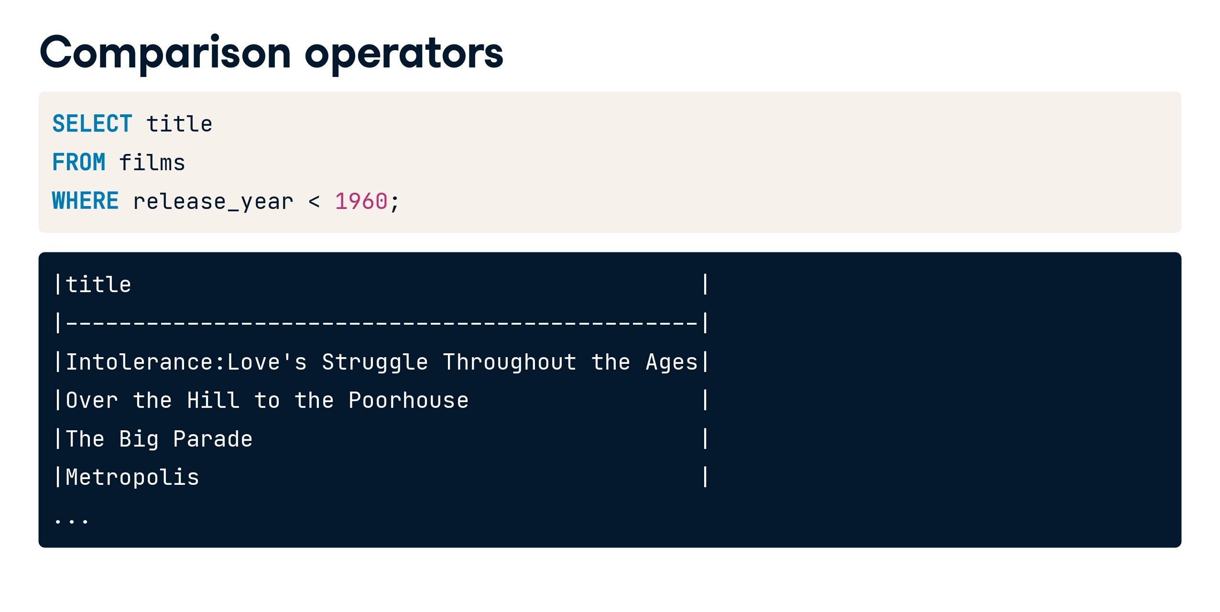

Slide 29
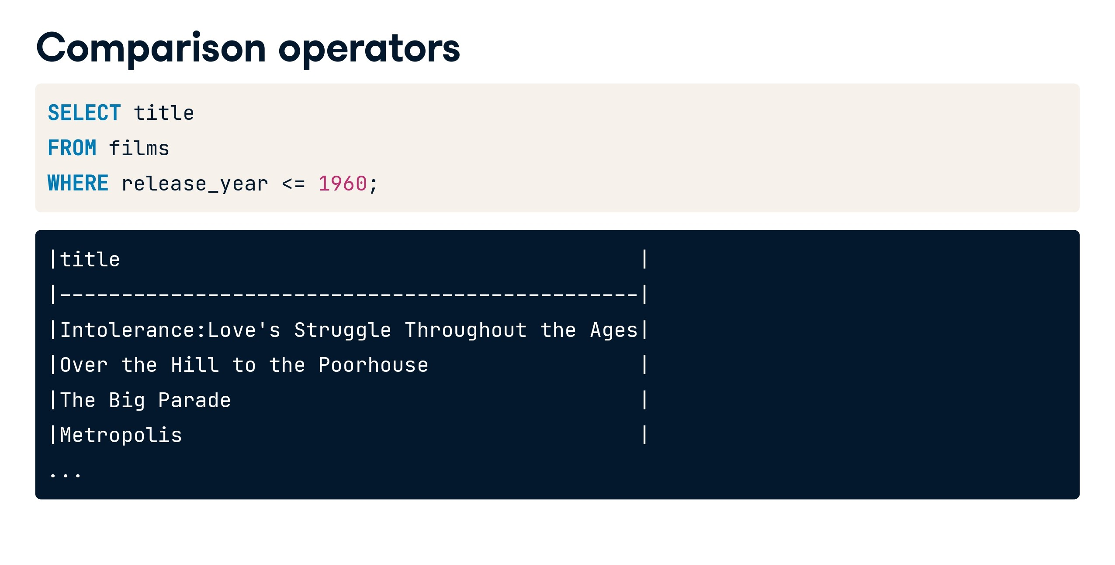

Slide 30
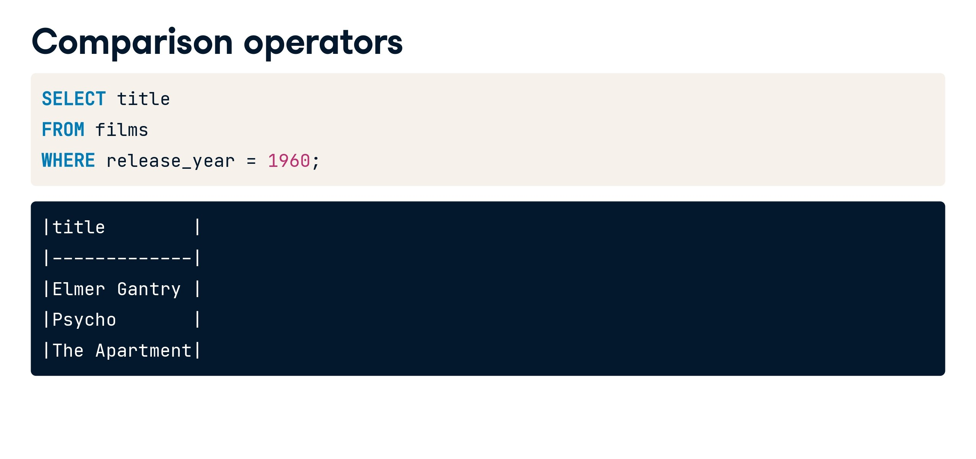

Slide 31
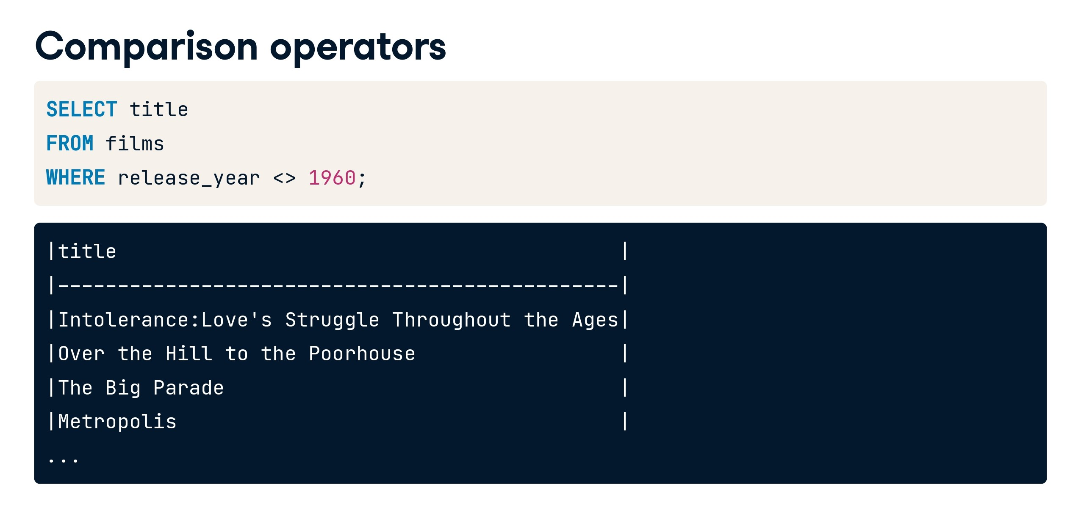

Slide 32
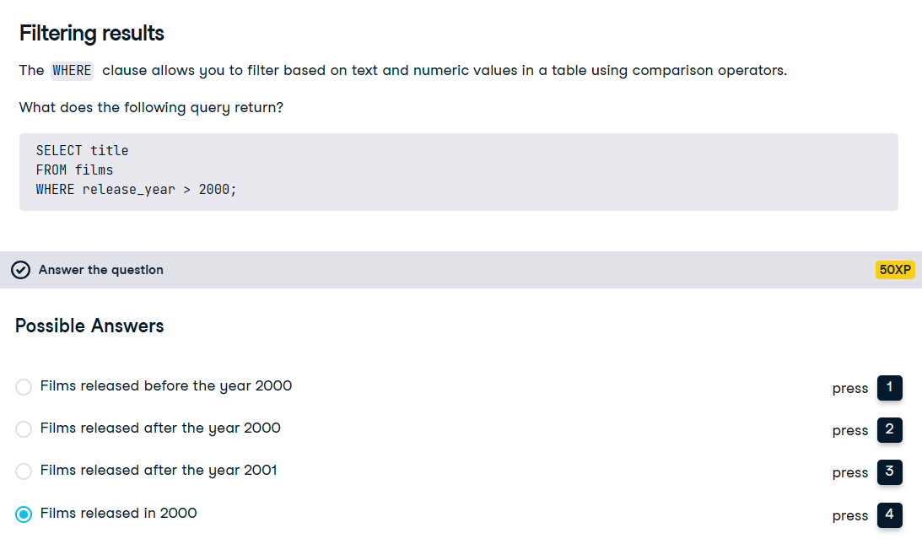

Slide 33
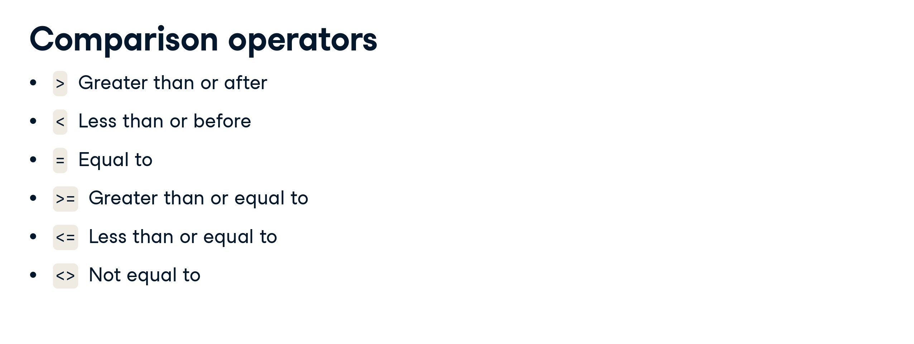

Slide 34
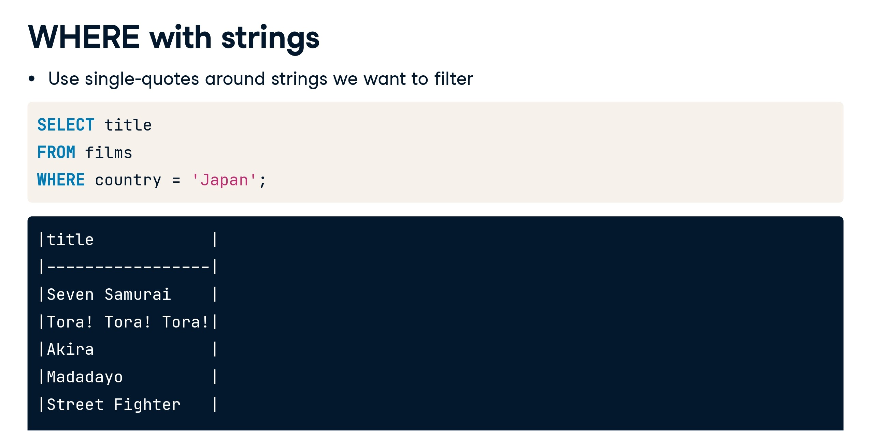

Slide 35
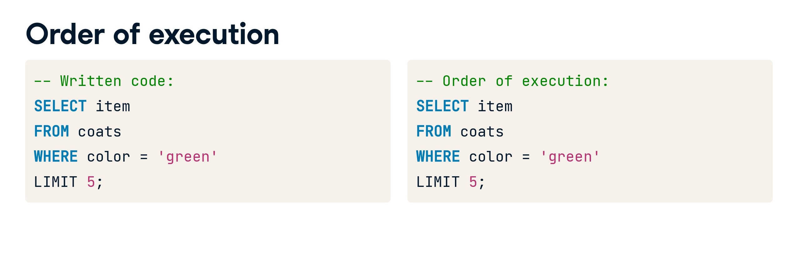

Slide 36
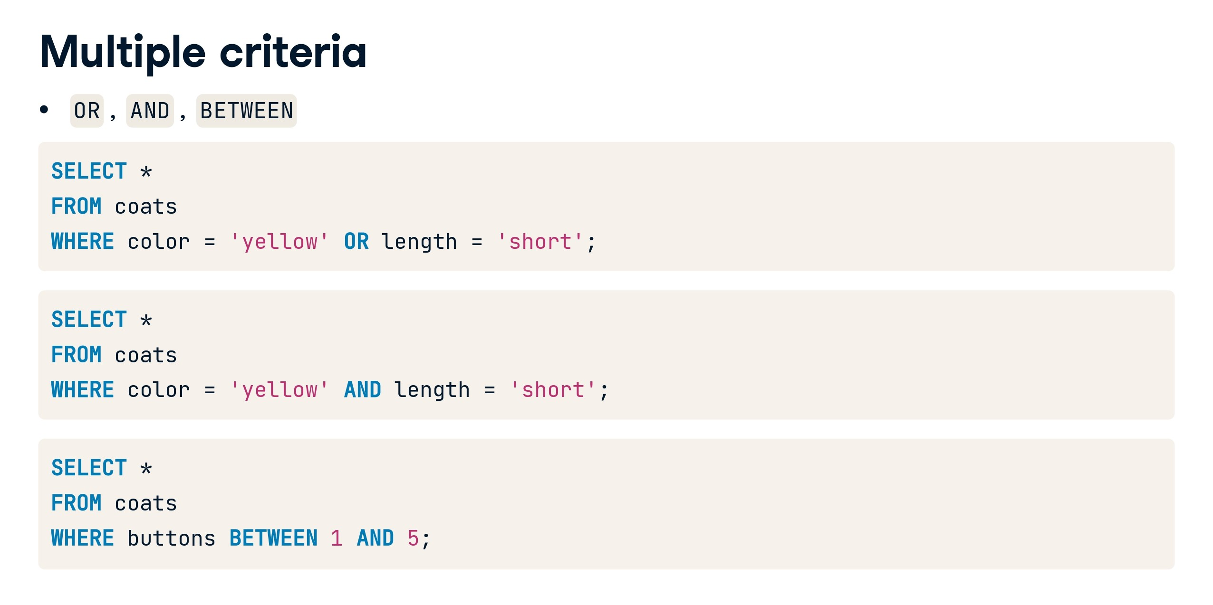

Slide 37
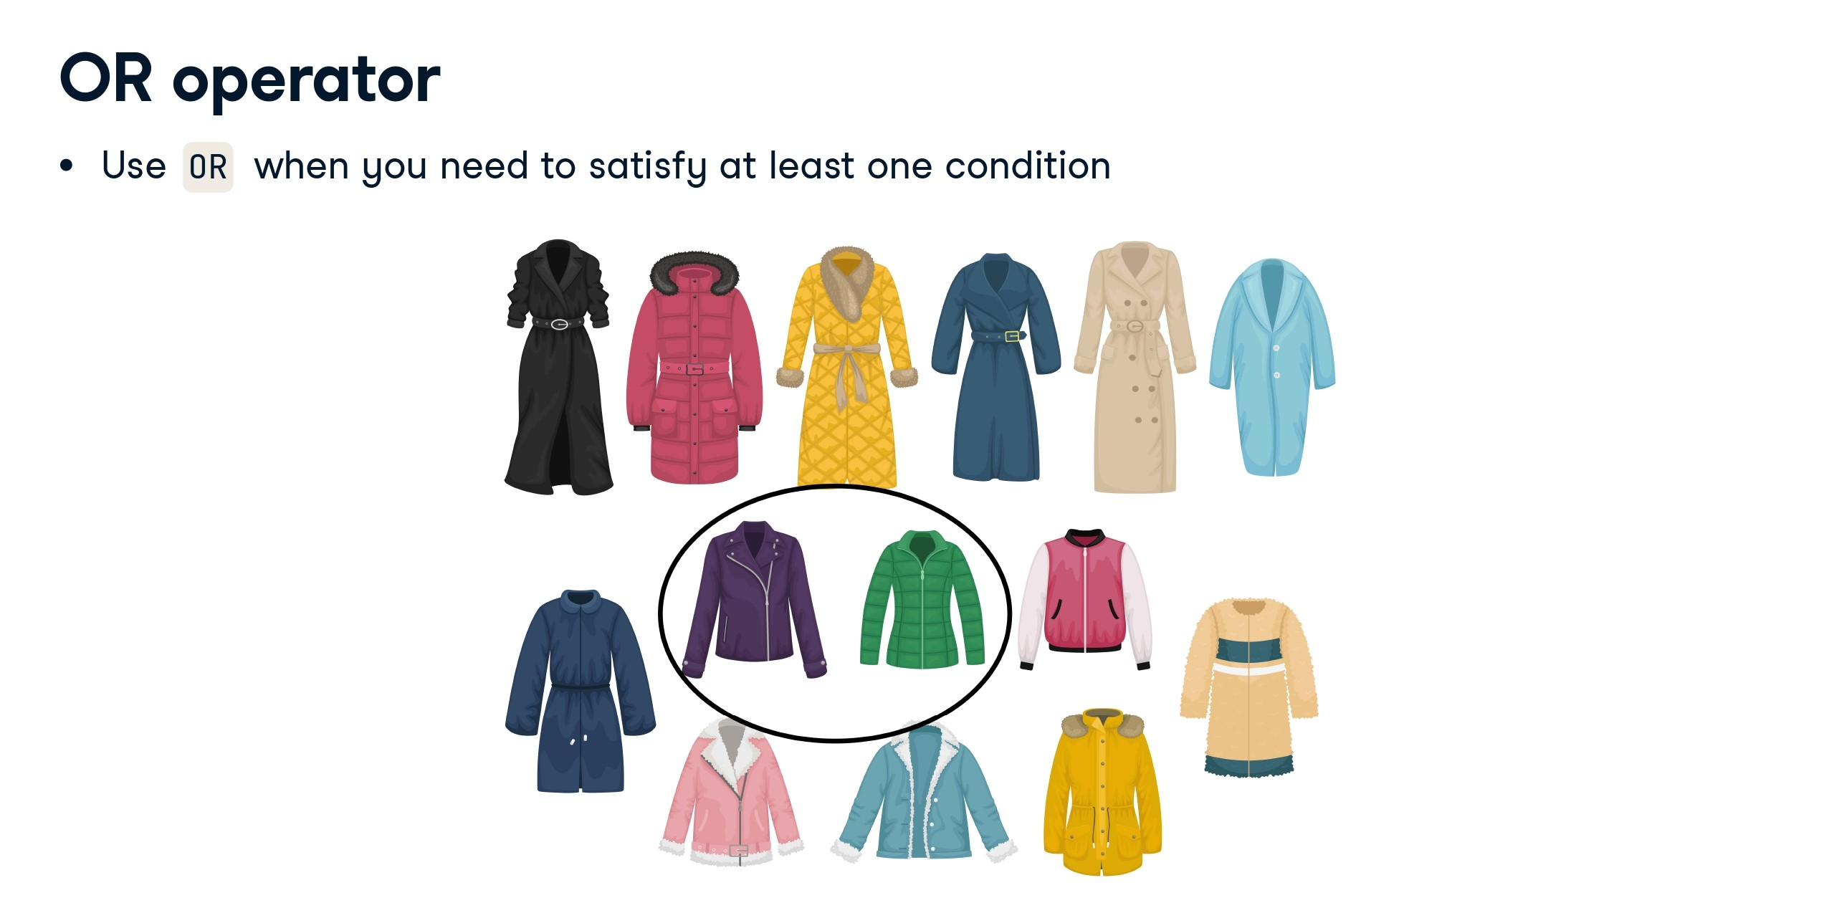

Slide 38
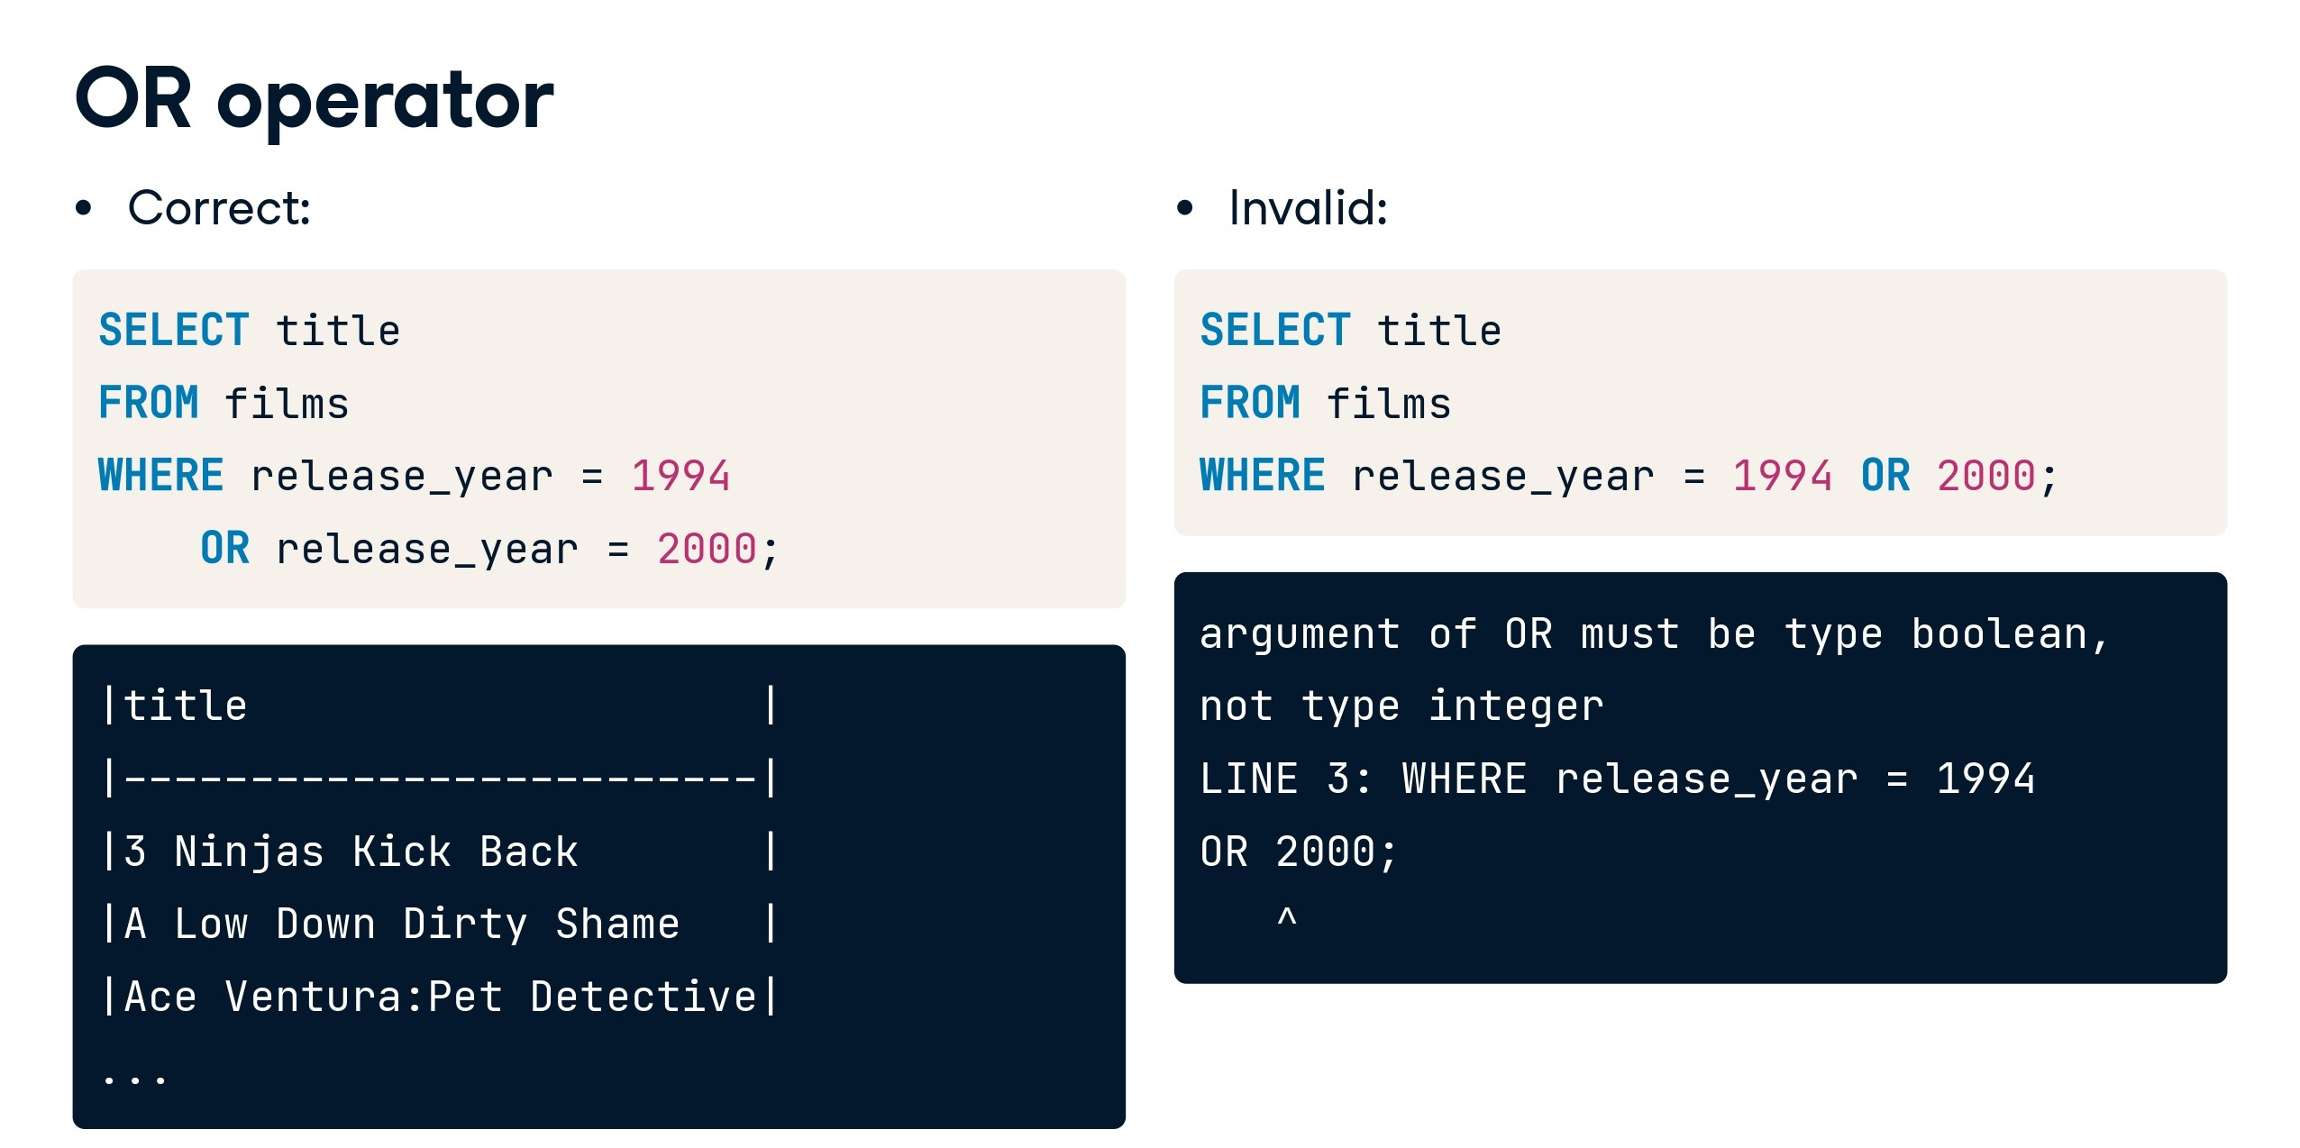

Slide 39
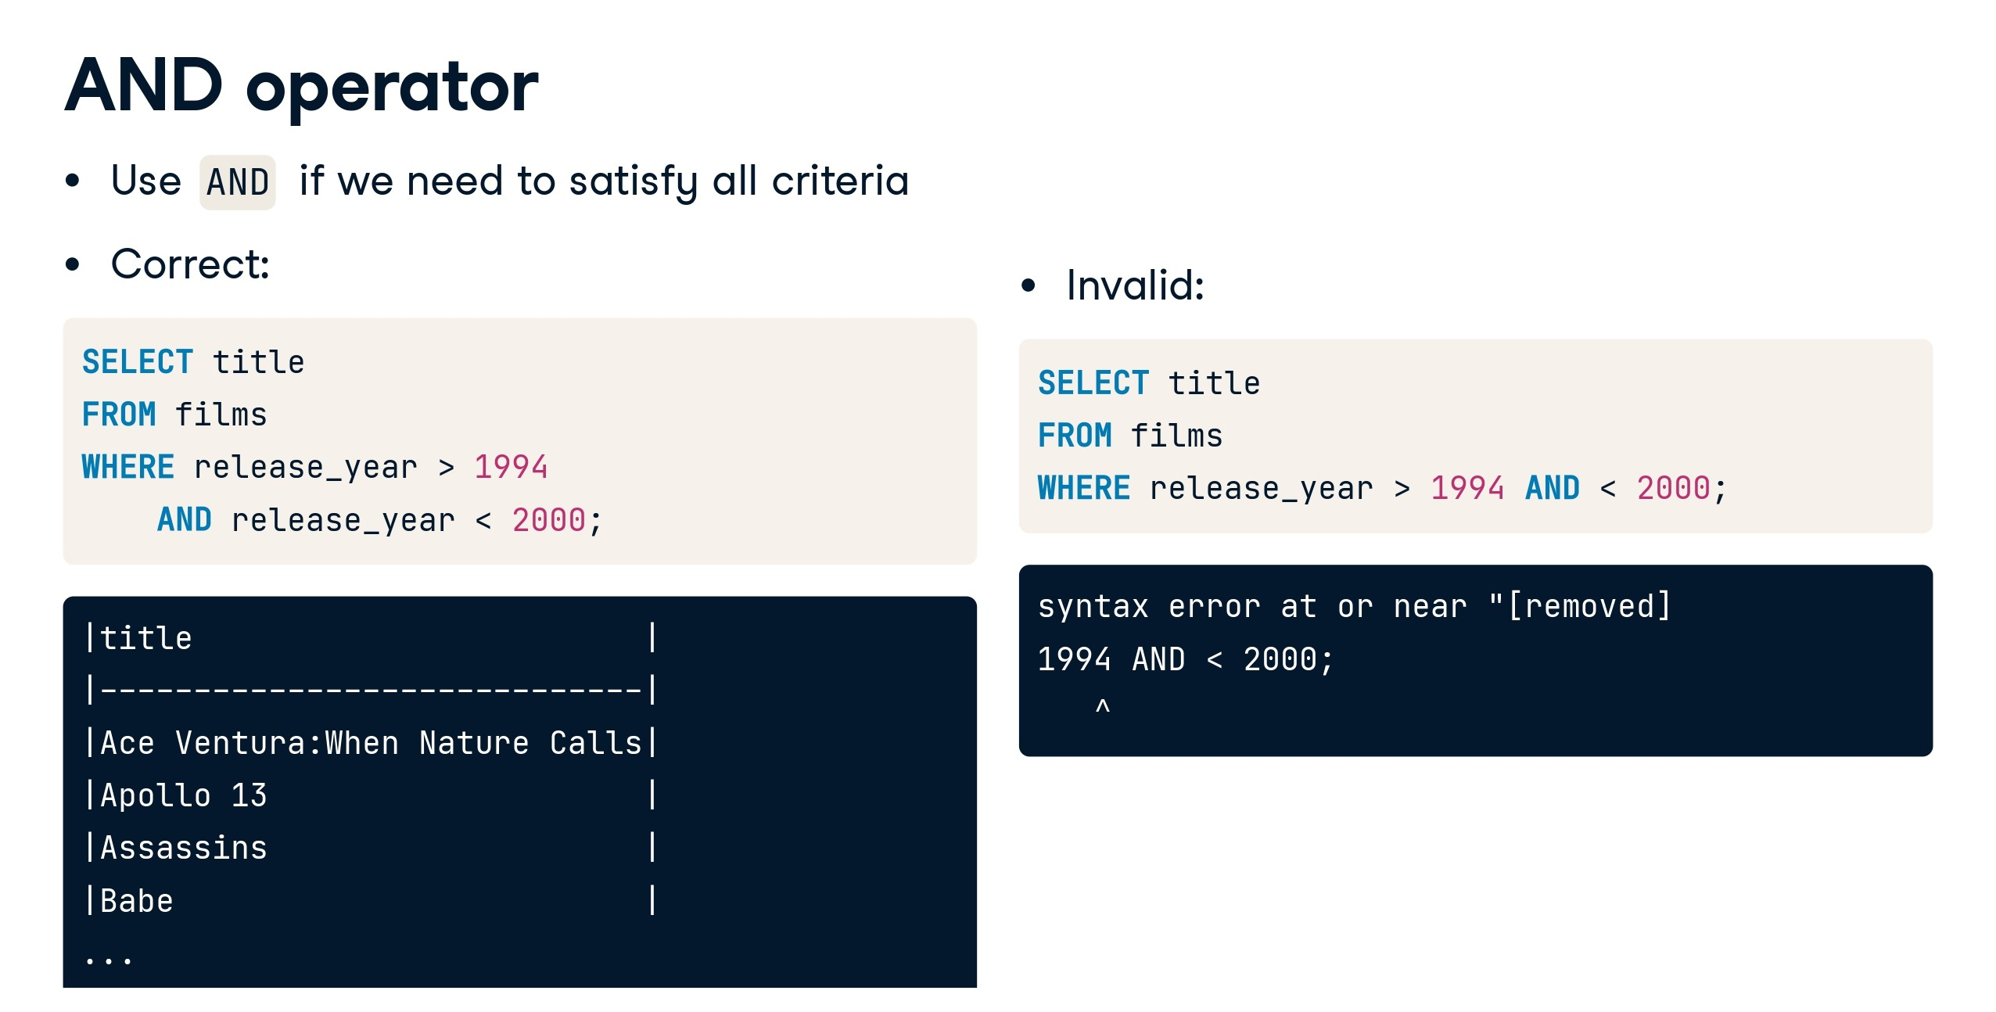

Slide 40
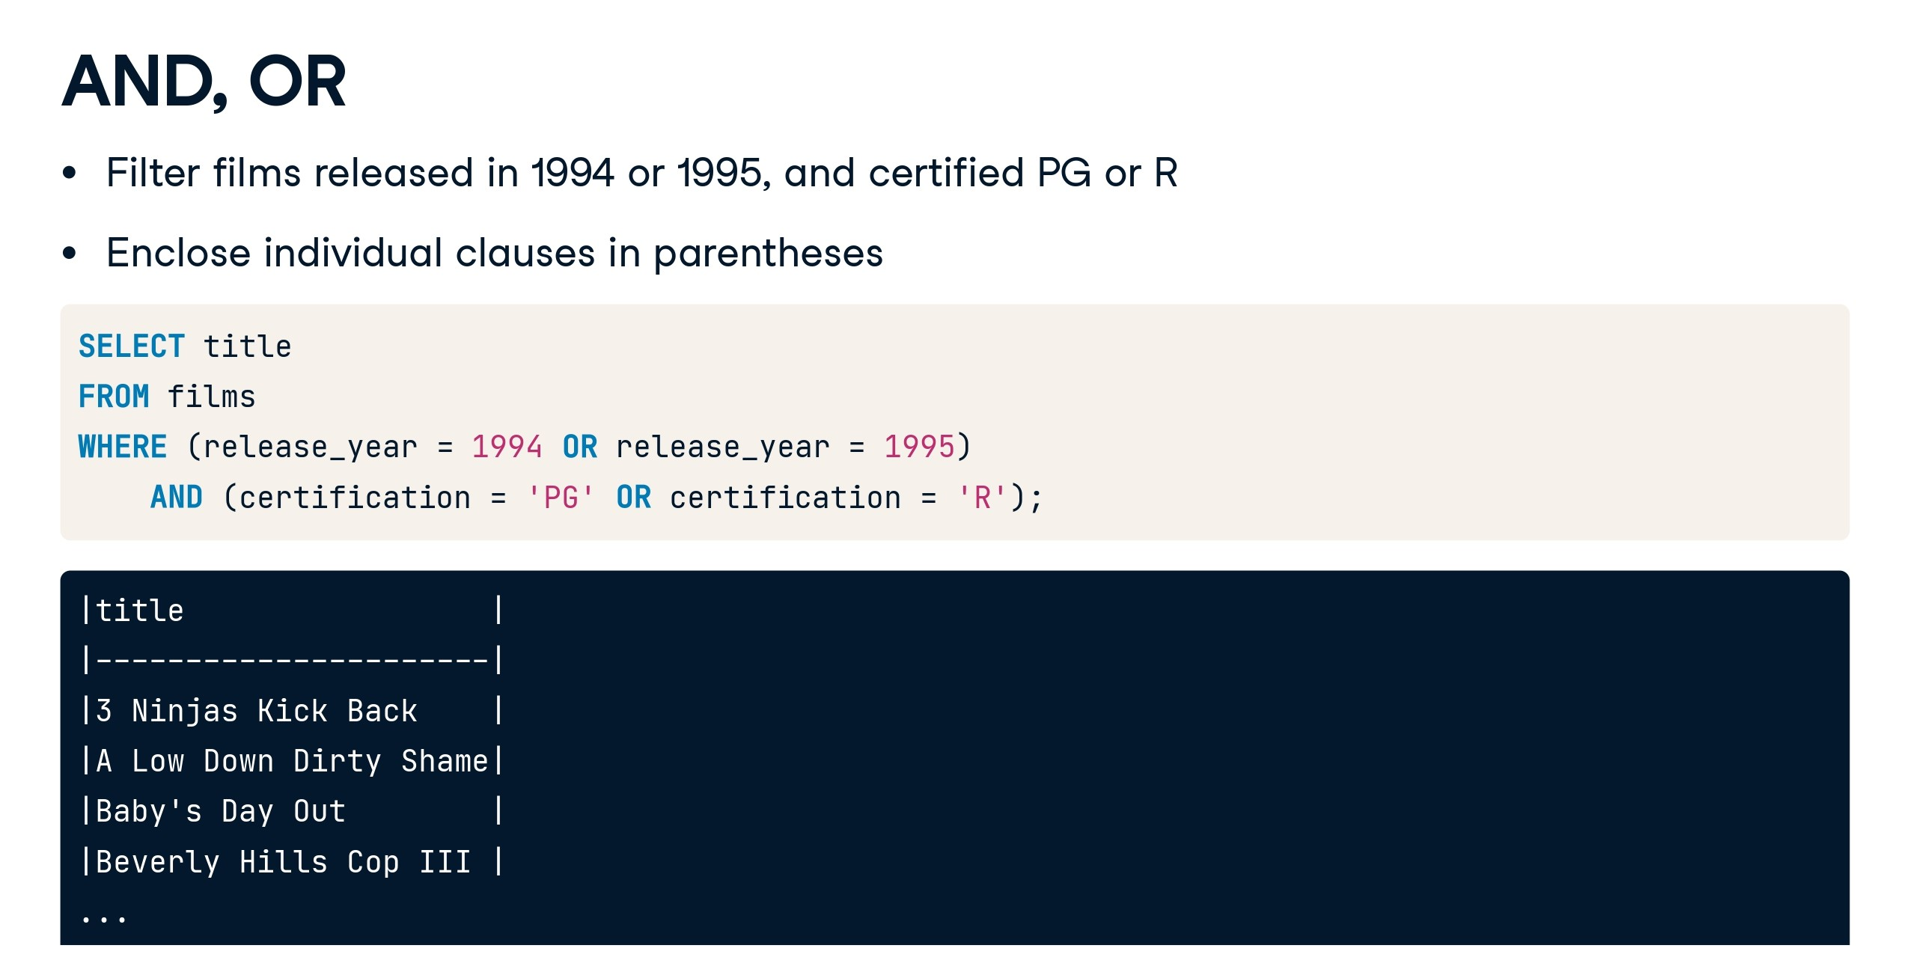

Slide 41
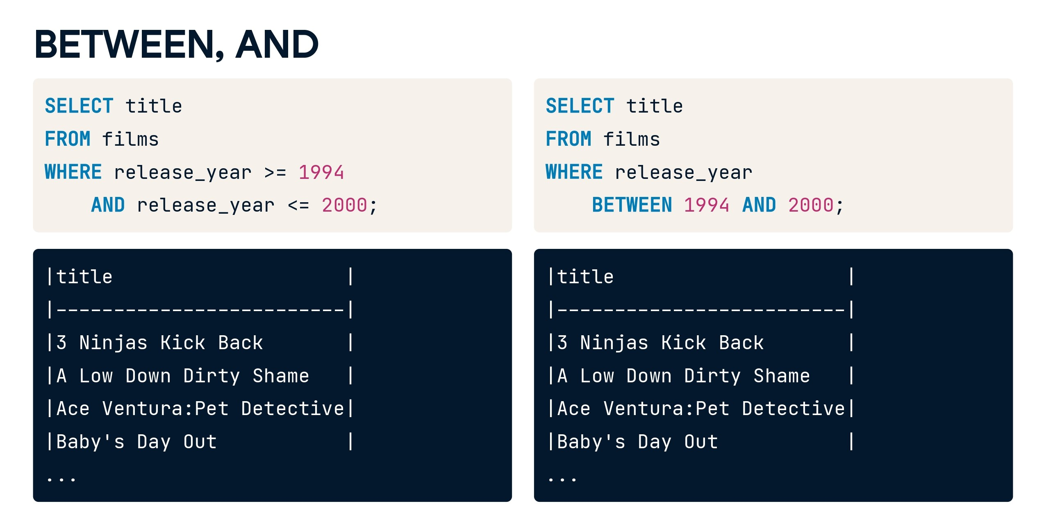

Slide 42
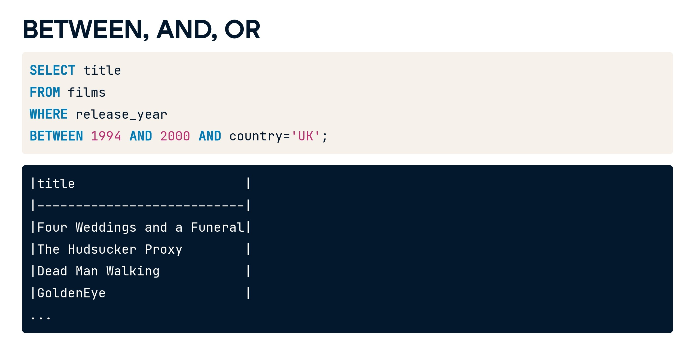

Slide 43
Case study 1
CREATE TABLE Employees (
emp_id INTEGER PRIMARY KEY,
first_name VARCHAR(50),
last_name VARCHAR(50),
department VARCHAR(50),
position VARCHAR(50),
hire_date DATE,
salary DECIMAL(10, 2),
years_of_exp INTEGER
);

Slide 44
INSERT INTO Employees (emp_id, first_name, last_name, department, position, hire_date, salary, years_of_exp)
VALUES
(1, 'John', 'Doe', 'Sales', 'Sales Manager', '2020-01-15', 55000.00, 5),
(2, 'Jane', 'Smith', 'Finance', 'Financial Analyst', '2019-07-08', 48000.00, 3),
(3, 'Mike', 'Johnson', 'IT', 'Software Engineer', '2021-03-20', 65000.00, 7),
(4, 'Emily', 'Williams', 'HR', 'HR Manager', '2018-05-10', 60000.00, 8),
(5, 'David', 'Brown', 'Sales', 'Sales Representative', '2022-02-05', 42000.00, 2);

Slide 45
Question 1:
let's solve some more complex problems using the WHERE clause:
Select employees from the Sales department who have more than 4 years of experience.

Slide 46
Solution 1:
Select employees from the Sales department who have more than 4 years of experience:
SELECT *
FROM Employees
WHERE department = 'Sales' AND years_of_exp > 4;

Slide 47
Question 2: Select employees whose hire date is before January 1, 2021, and their salary is greater than 50000.

Slide 48
Solution 2:
Select employees whose hire date is before January 1, 2021, and their salary is greater than 50000.
SELECT * FROM Employees WHERE hire_date < '2021-01-01' AND salary > 50000.00;

Slide 49


Slide 50
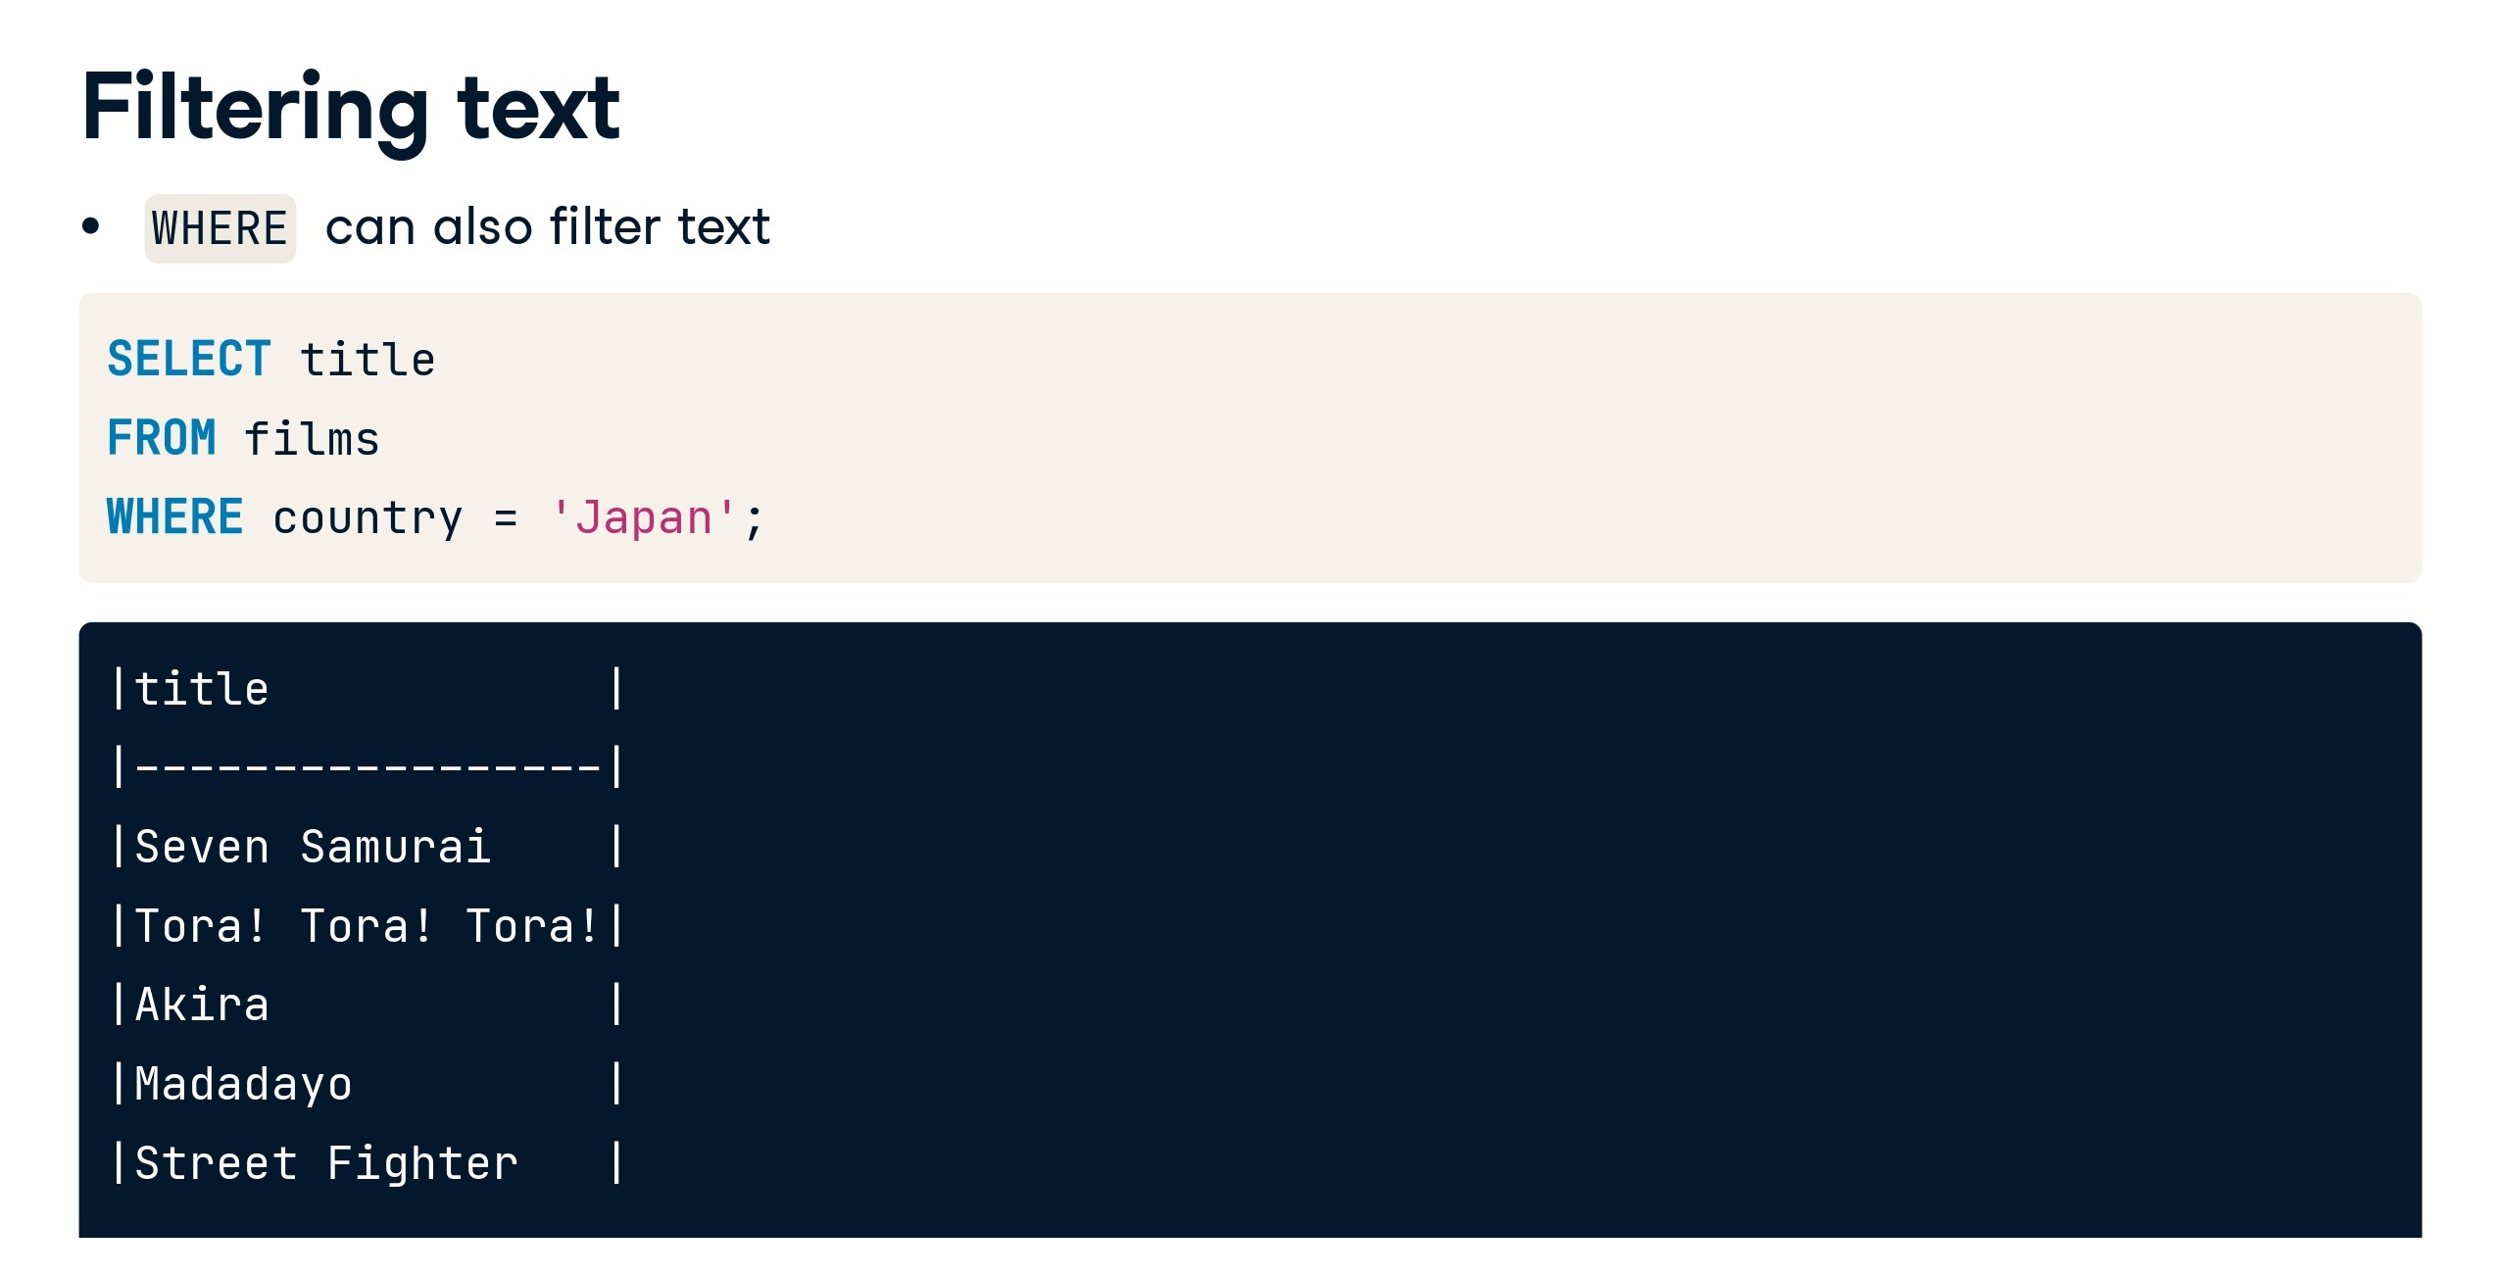

Slide 51
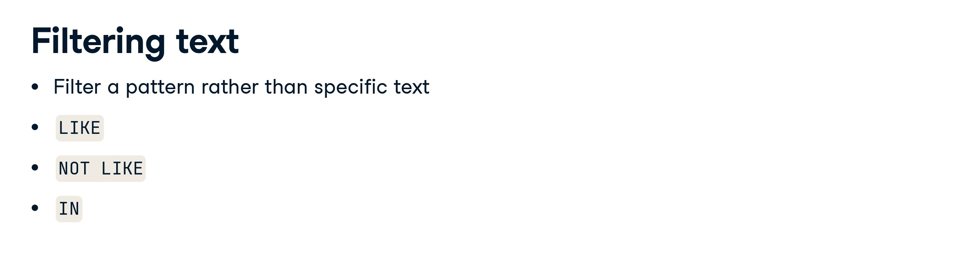

Slide 52
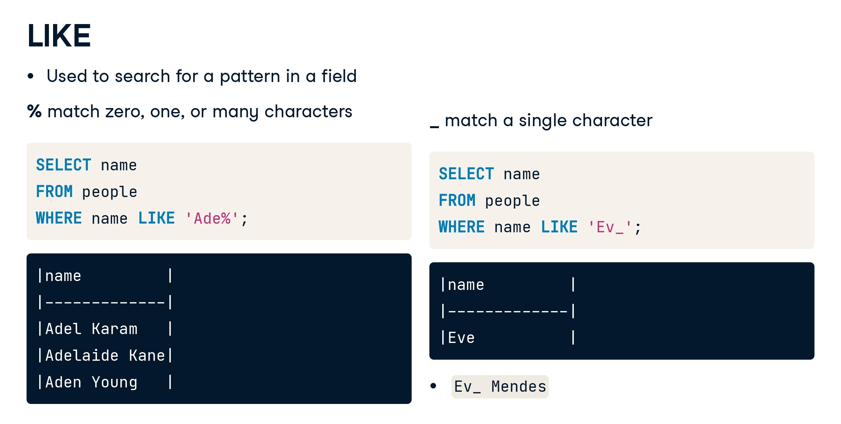

Slide 53
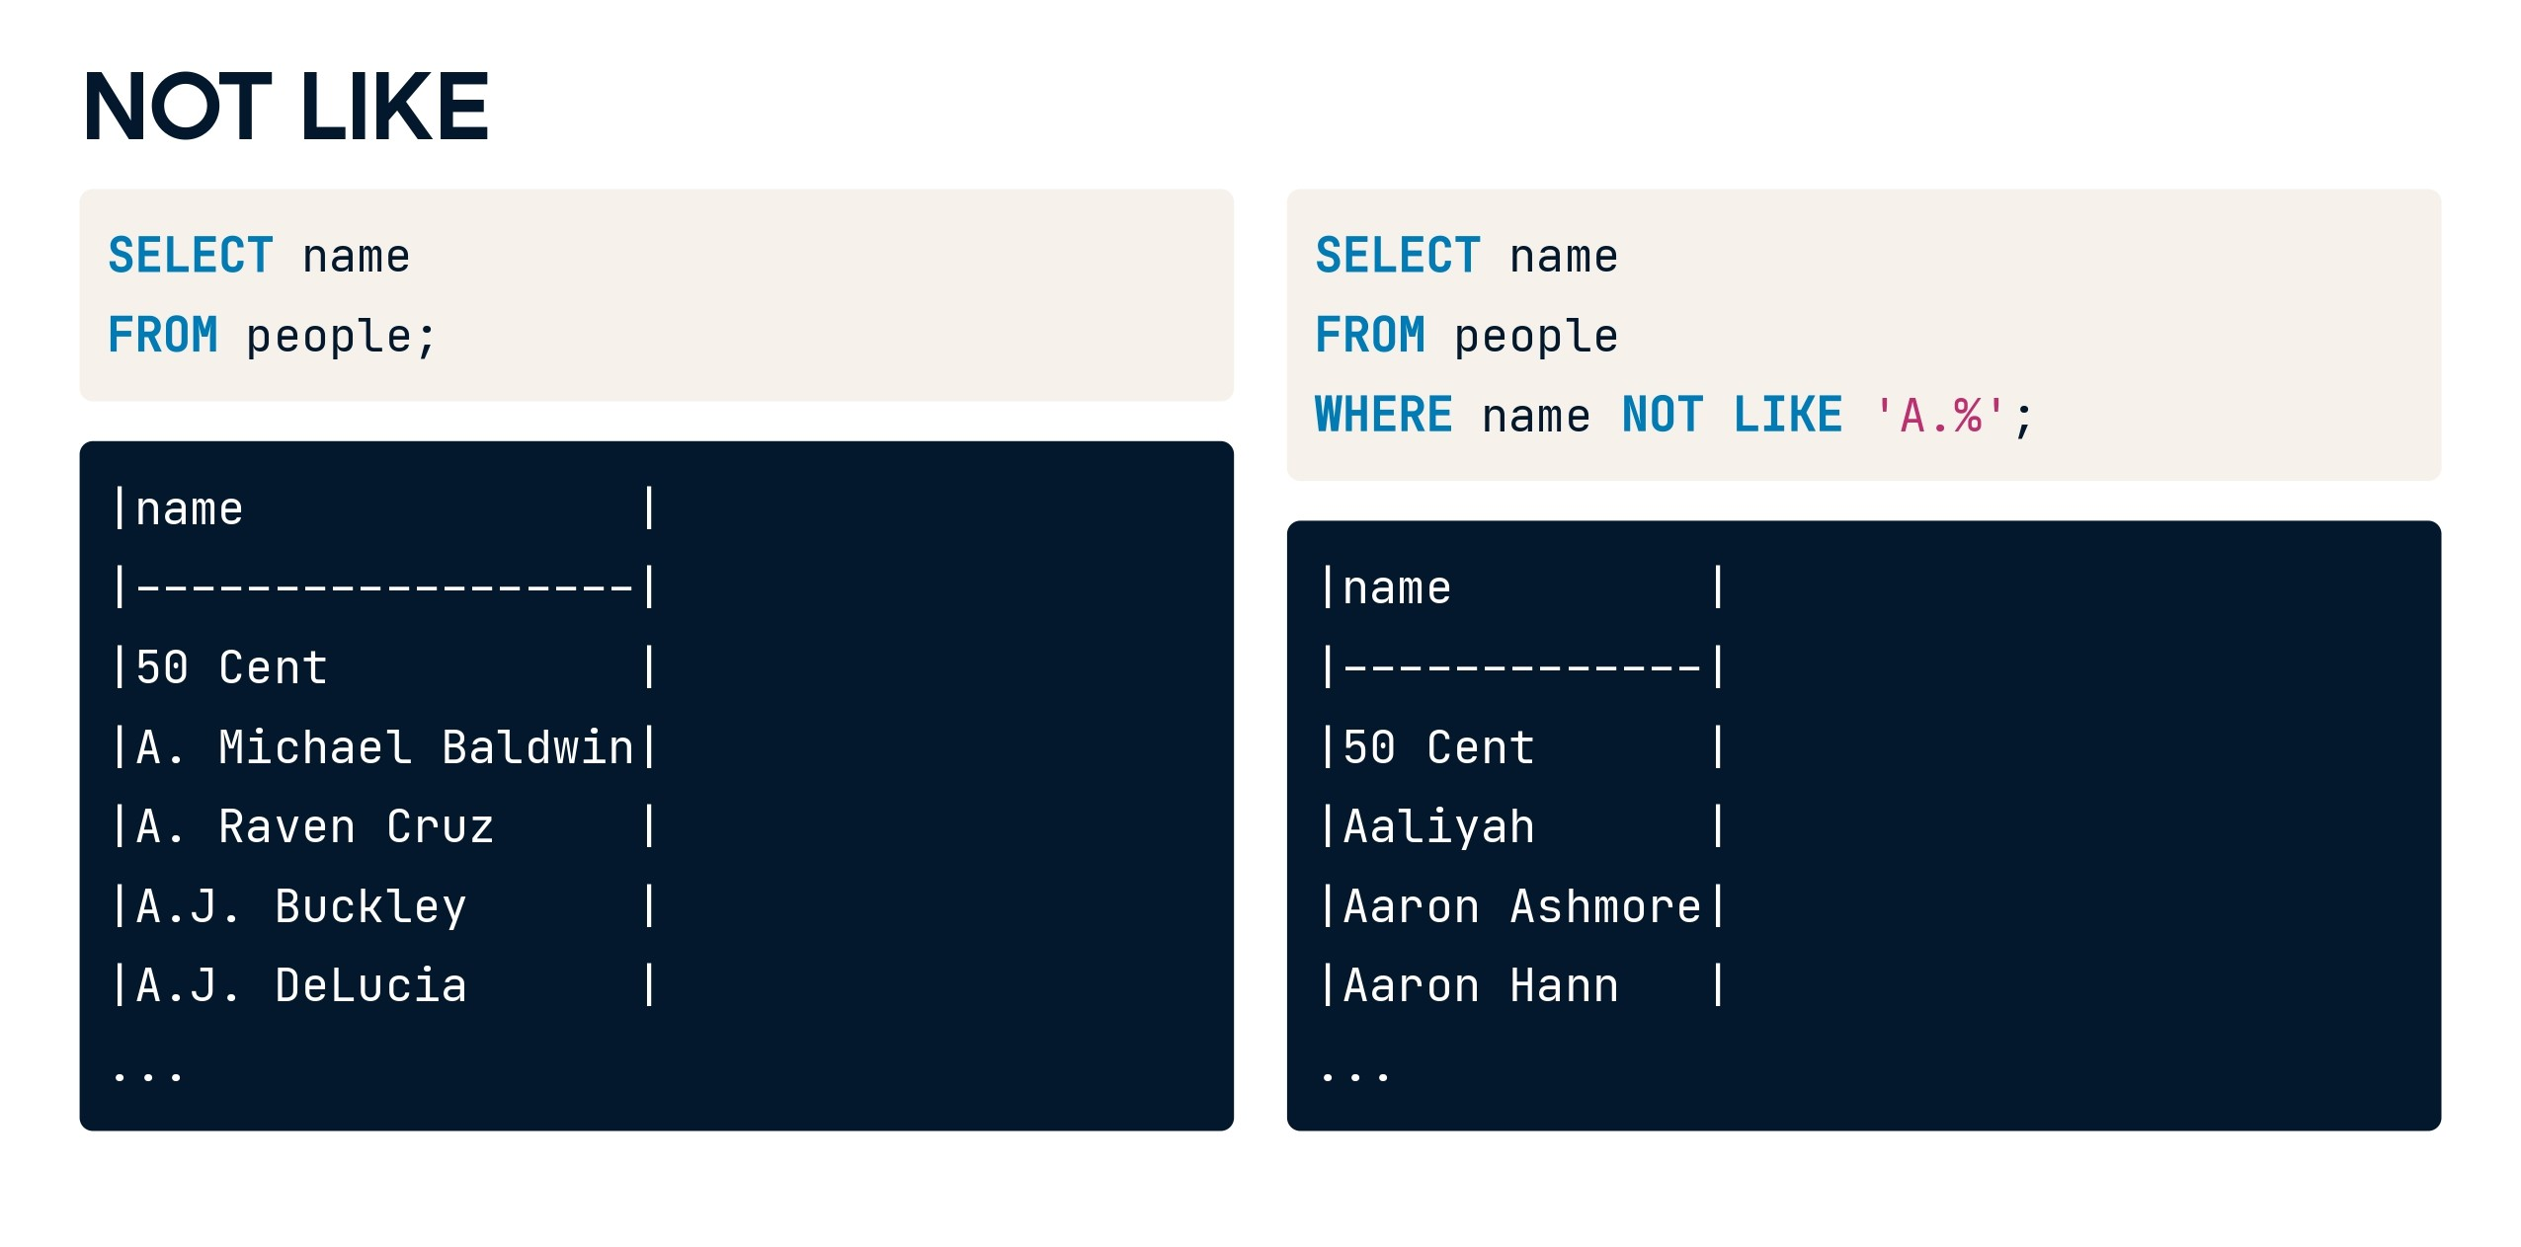

Slide 54
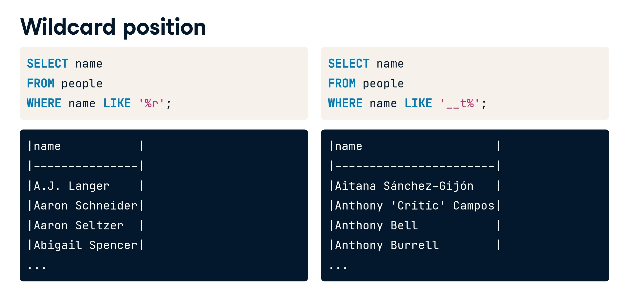

Slide 55
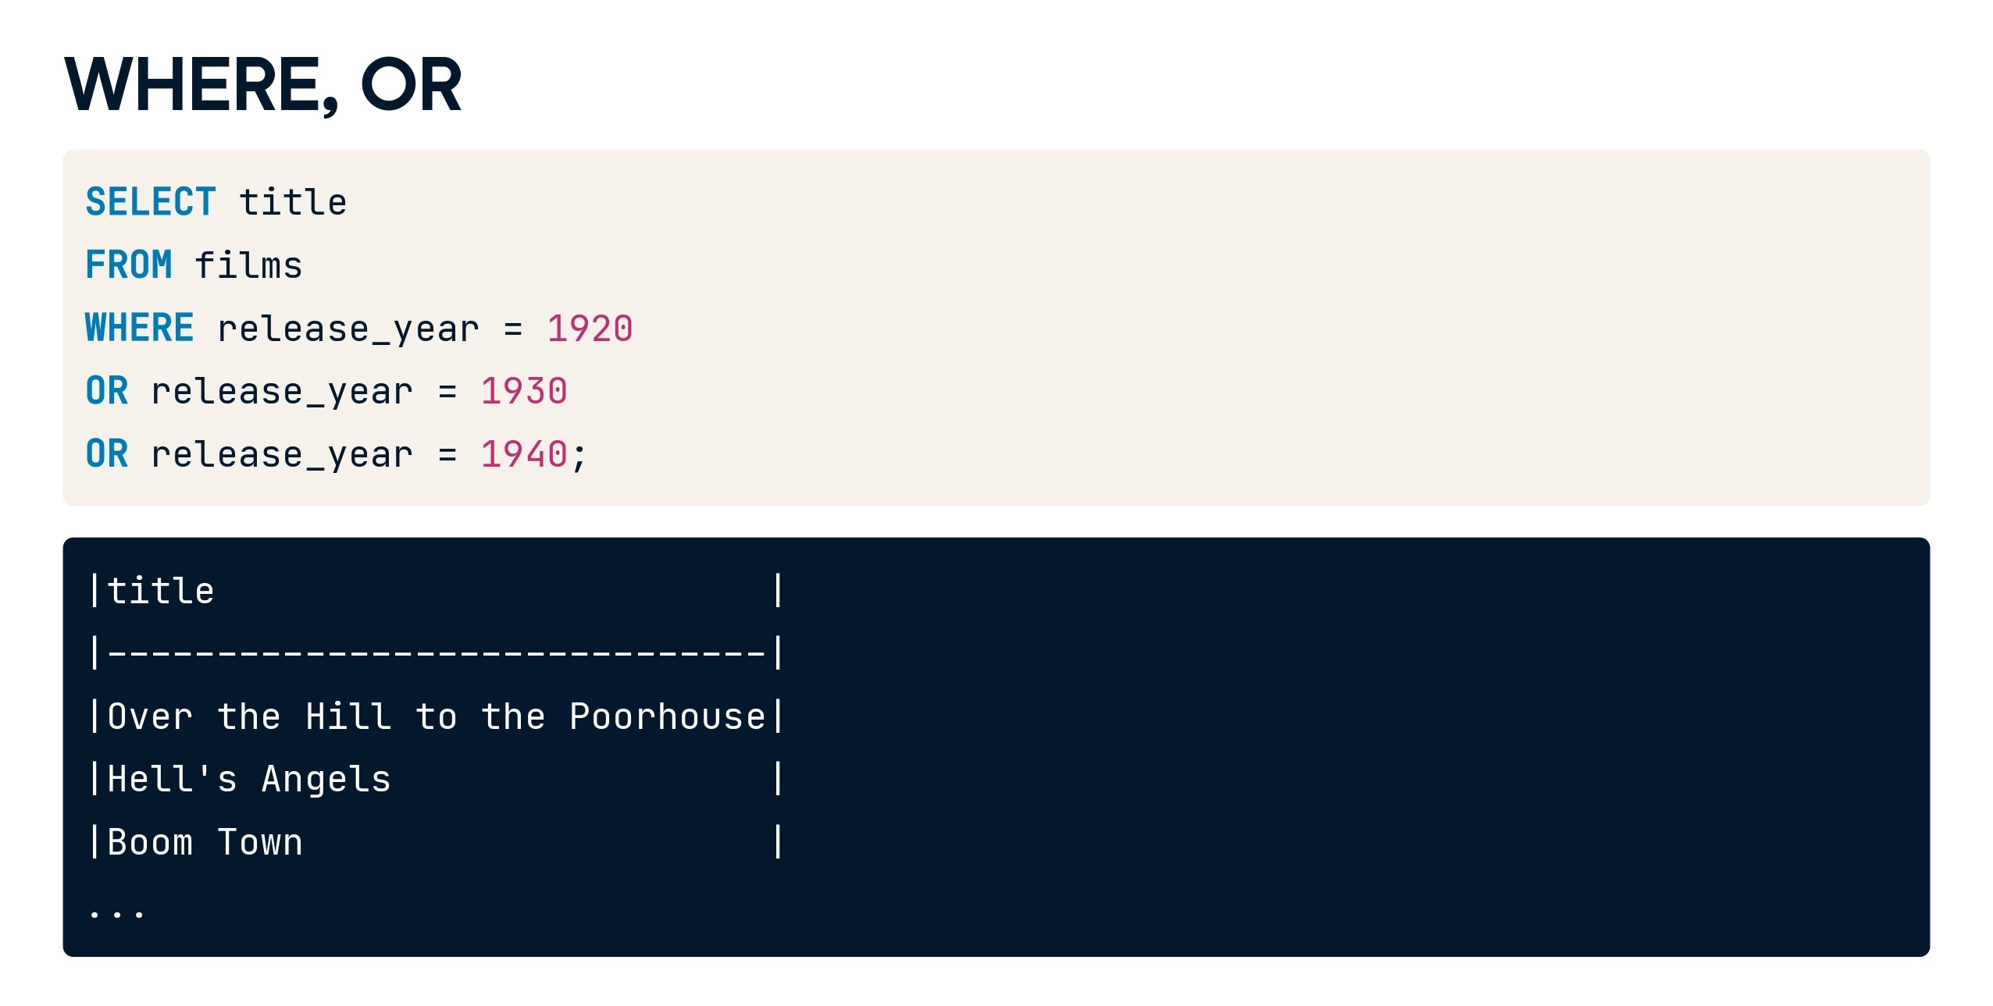

Slide 56
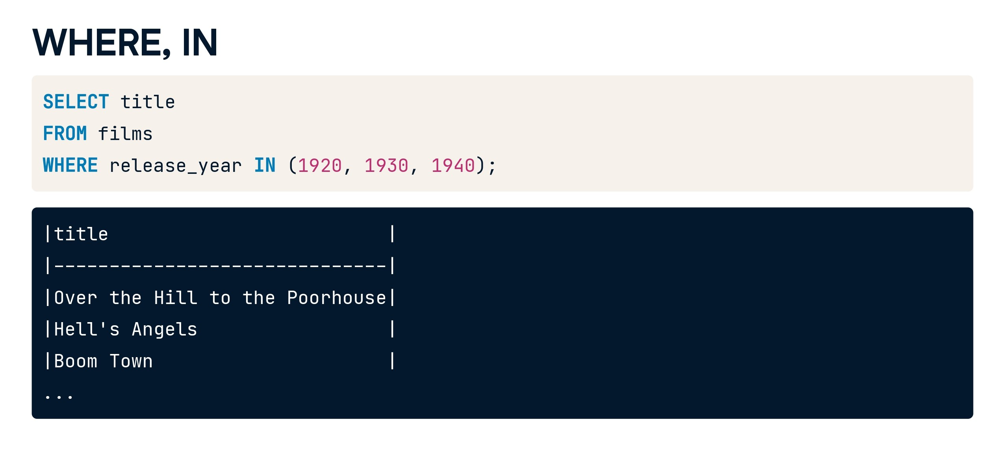

Slide 57
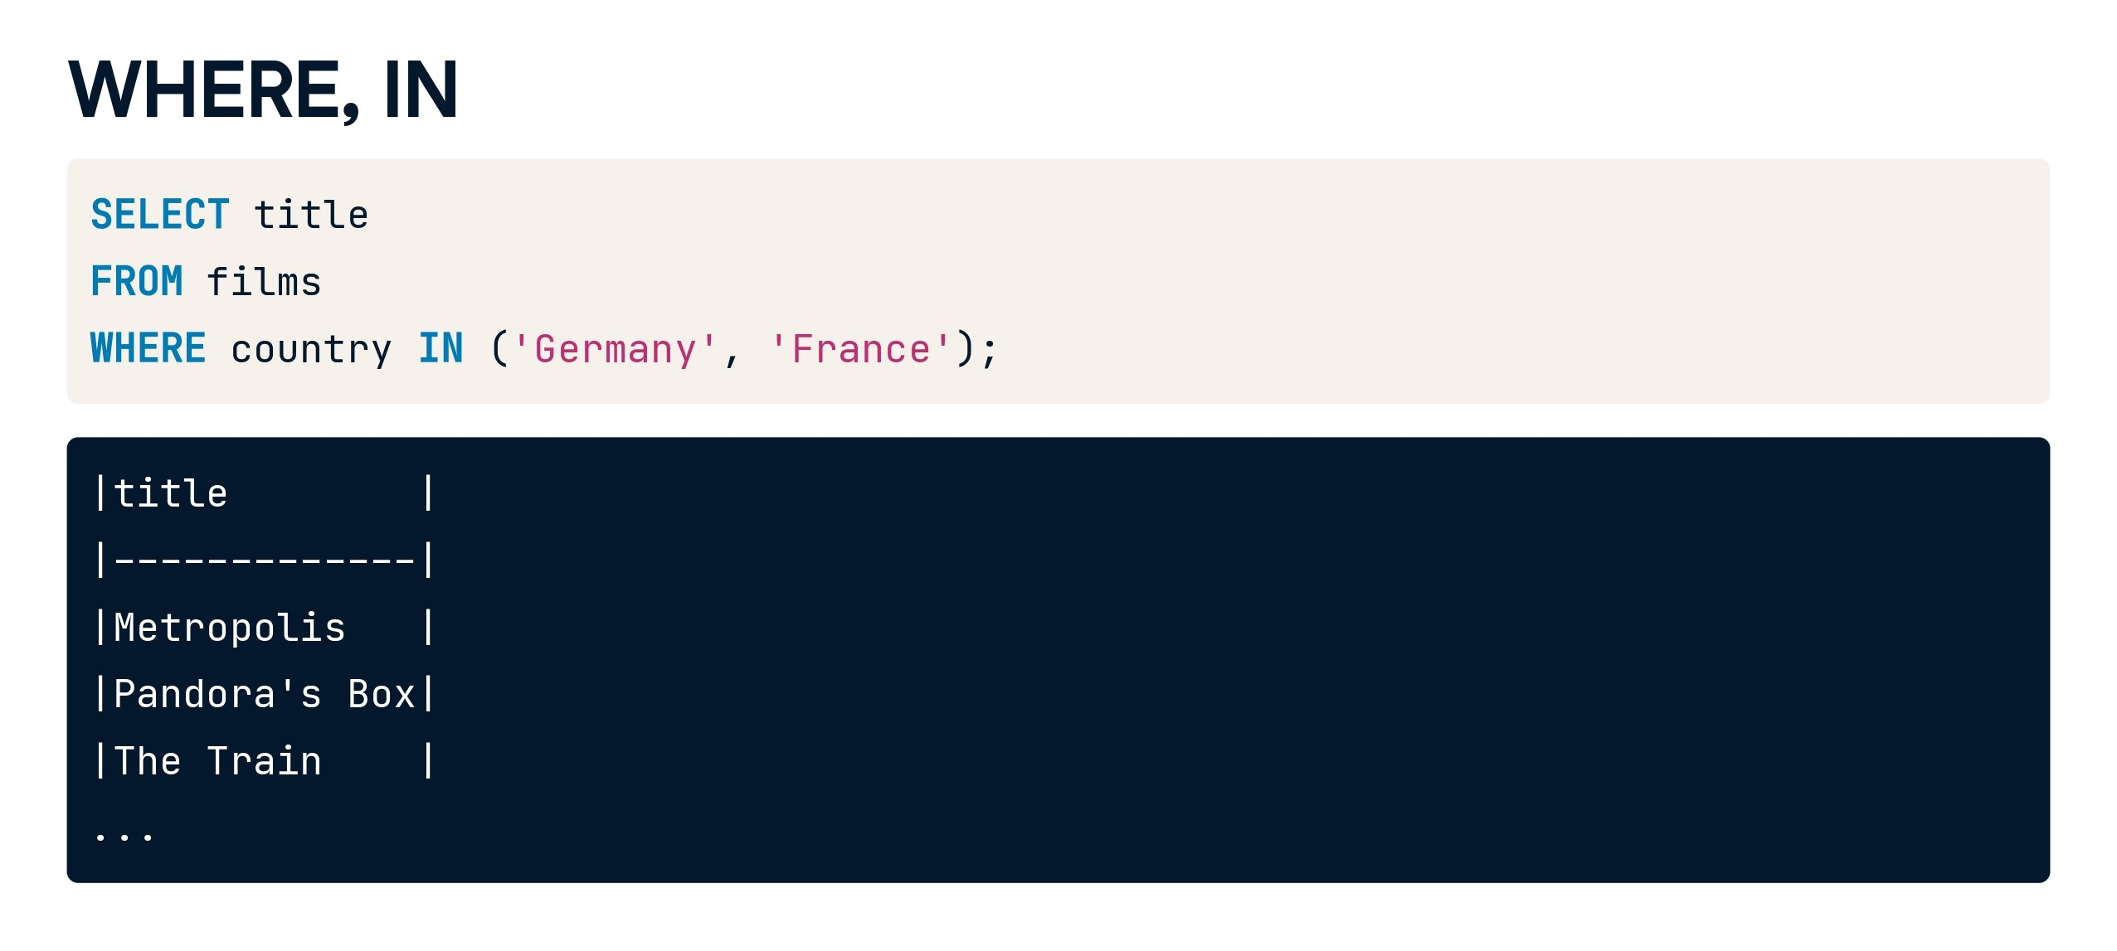

Slide 58


Slide 59
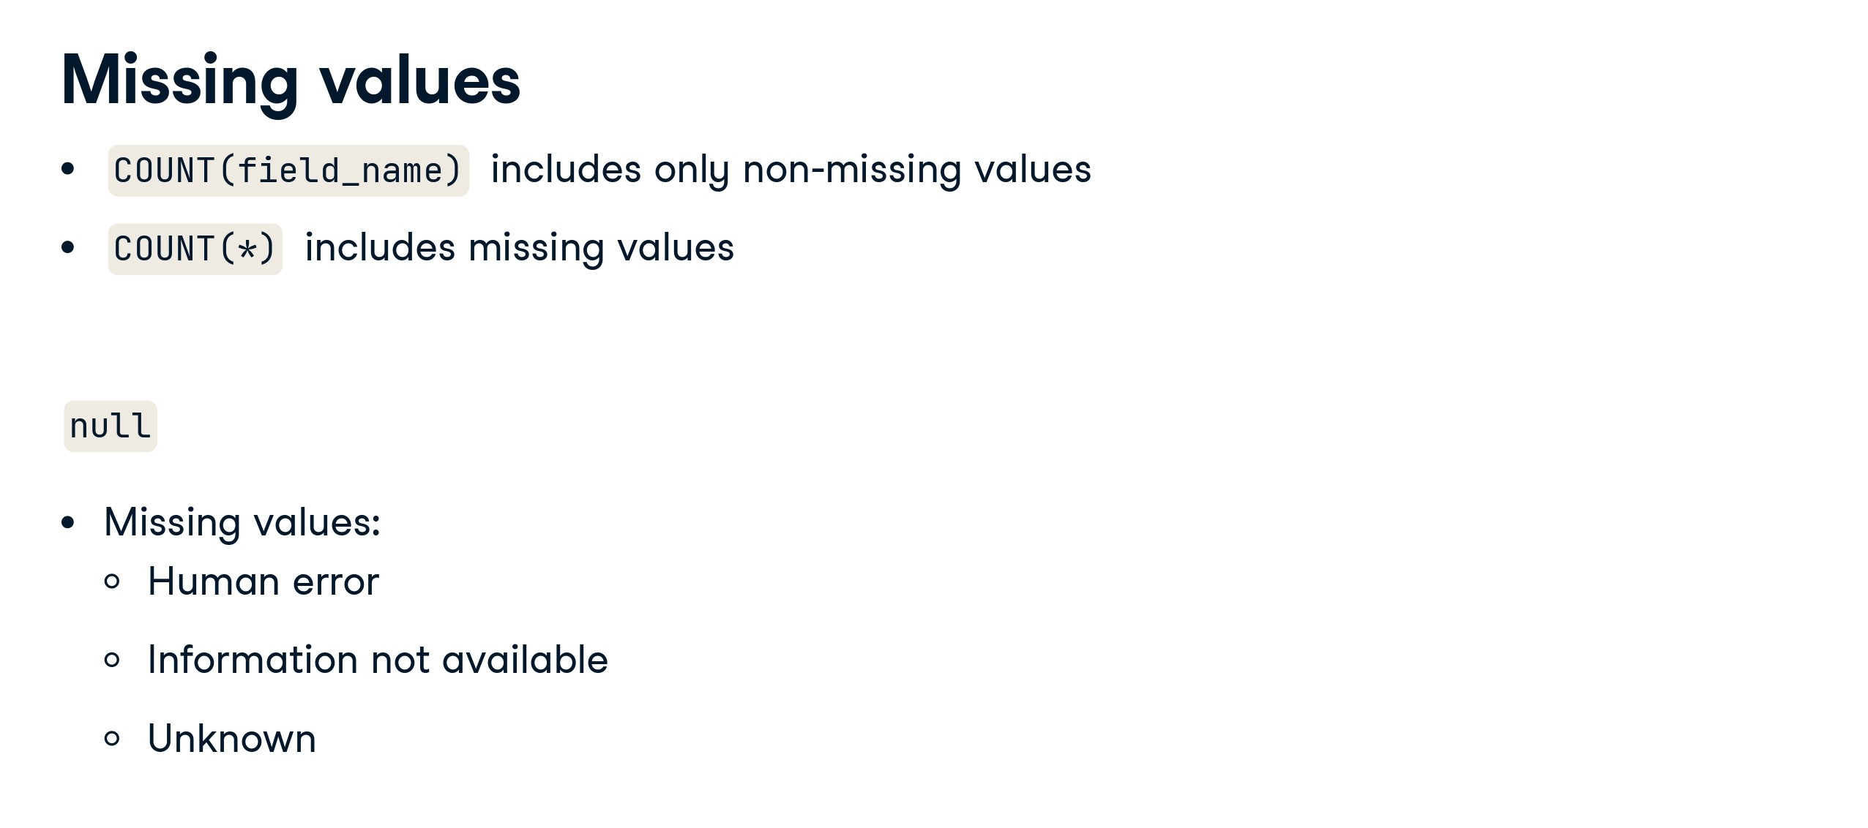

Slide 60
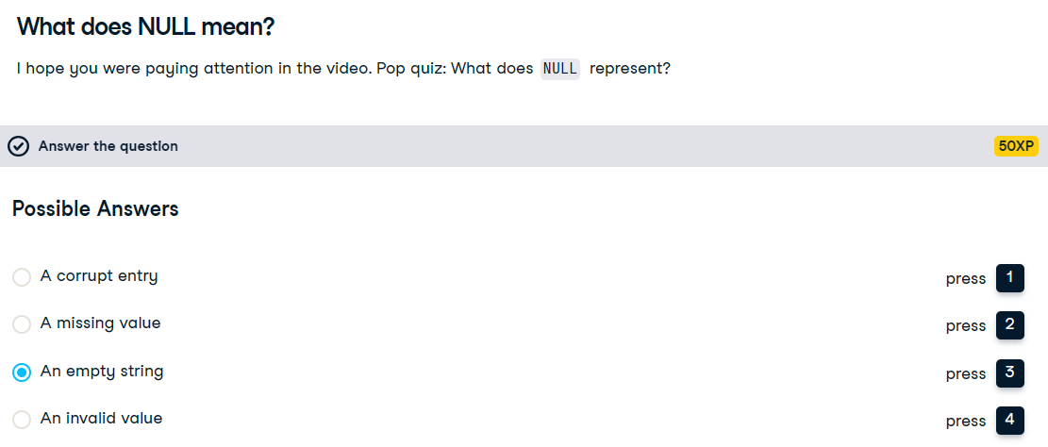

Slide 61
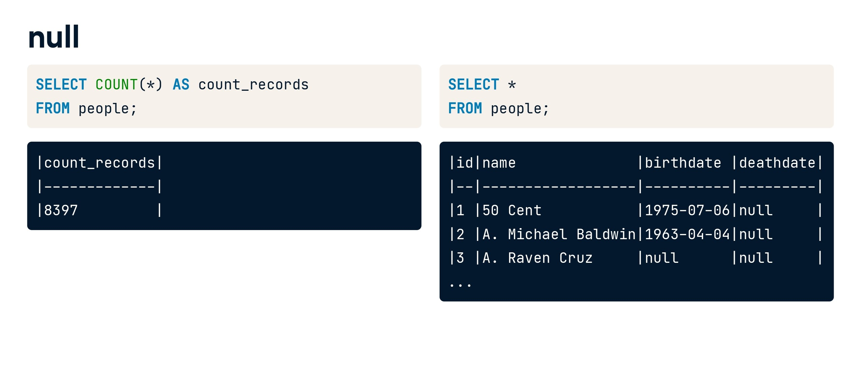

Slide 62
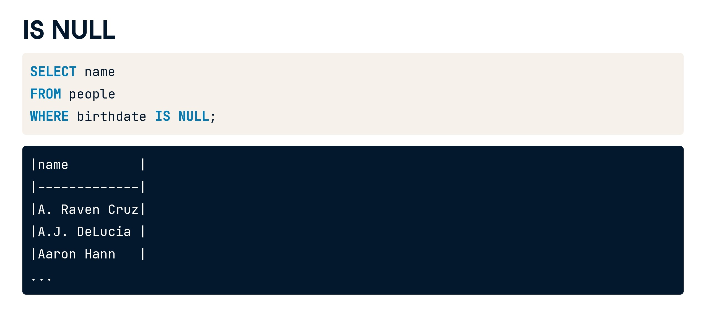

Slide 63
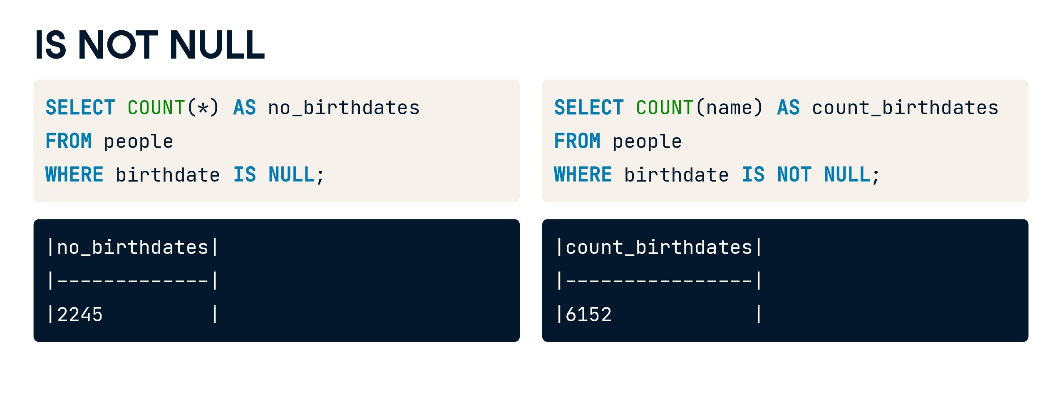

Slide 64
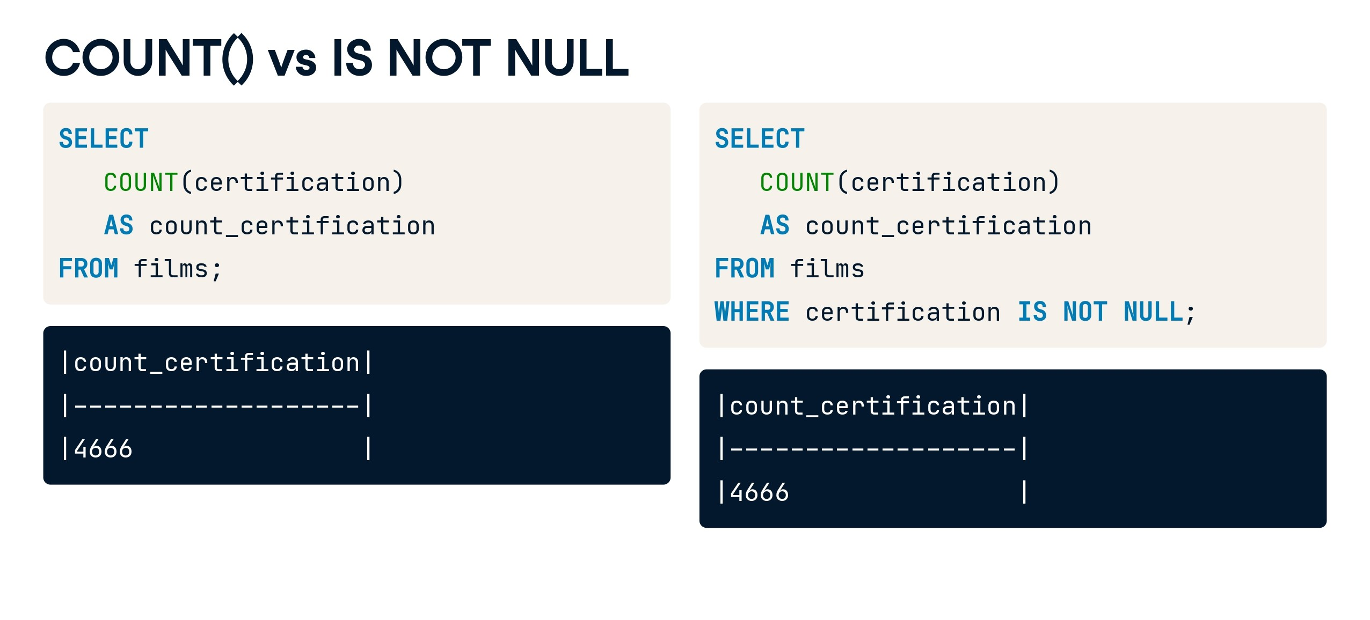

Slide 65


Slide 66
Question 3:
Select employees whose hire date is before January 1, 2021, and their salary is greater than 50000.
Question 4:
Select employees whose first name starts with 'J' and are either Financial Analysts or HR Managers.

Slide 67
Solution 3:
Select employees whose hire date is before January 1, 2021, and their salary is greater than 50000.
SELECT * FROM Employees WHERE hire_date < '2021-01-01' AND salary > 50000.00;
Solution 4:
Select employees whose first name starts with 'J' and are either Financial Analysts or HR Managers.
SELECT * FROM Employees WHERE first_name LIKE 'J%' AND (position = 'Financial Analyst' OR position = 'HR Manager’);

Slide 68
Question 5:
Select employees whose salary is within a specific range and sort the result by salary in descending order.
Question 6: Select employees with more than 5 years of experience or whose salary is greater than 55000, and are not part of the IT department.

Slide 69
Solution 5:
Select employees whose salary is within a specific range and sort the result by salary in descending order.
SELECT * FROM Employees WHERE salary BETWEEN 40000.00 AND 60000.00 ORDER BY salary DESC;
Solution 6: Select employees with more than 5 years of experience or whose salary is greater than 55000, and are not part of the IT department.
SELECT * FROM Employees WHERE (years_of_exp > 5 OR salary > 55000.00) AND department <> 'IT'; These examples demonstrate some more complex scenarios using

Slide 70
End of Day 2
Any Query?

